Slide 1
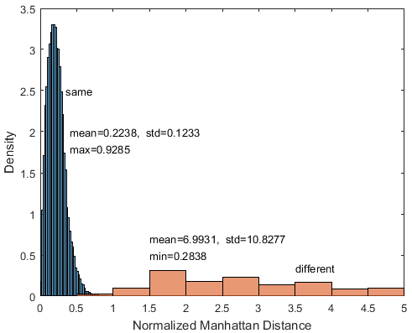
Gun Model Recognition Using Geometric Features of Contour Image
Zhisheng Zhou, Jun Han, Jiaxin Chen and Yuming Dong
Shenzhen Institute of Advanced Technology, CAS, China
A method to recognize a gun’s model based on image classification is presented.
The procedure involves contour image acquiring and classification based on geometric features.
Geometric features include area, circumference, maximum distance and Hu moment.
Experimental results show a high accuracy of larger than 99%.
The distribution of matching scores of positive and negative samples.

