Slide 1
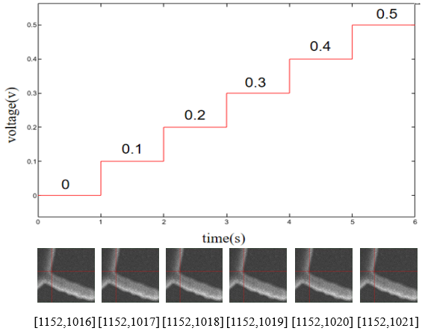
Nano Robotic Manipulator Positioning Accuracy Measurement By Secondary Electron Image
Litao Yang, Lue Zhang, Zhi Qu, Zengsheng Li, Zhan Yang
Robotics and Microsystems Center, School of Mechanical and Electric Engineering, Soochow University, Suzhou, China
Zengsheng Li
School of Mechanical Engineering, Tianjin University, Tianjin, China.
The mapping relationship between SEM image pixel and actual displacement is established.
Construct characteristic areas to track displacements at the nanometer scale.
The operation machine outputs a displacement of 2nm to verify the effectiveness of the displacement monitoring method.
1.81nm detection accuracy verification

