Slide 1
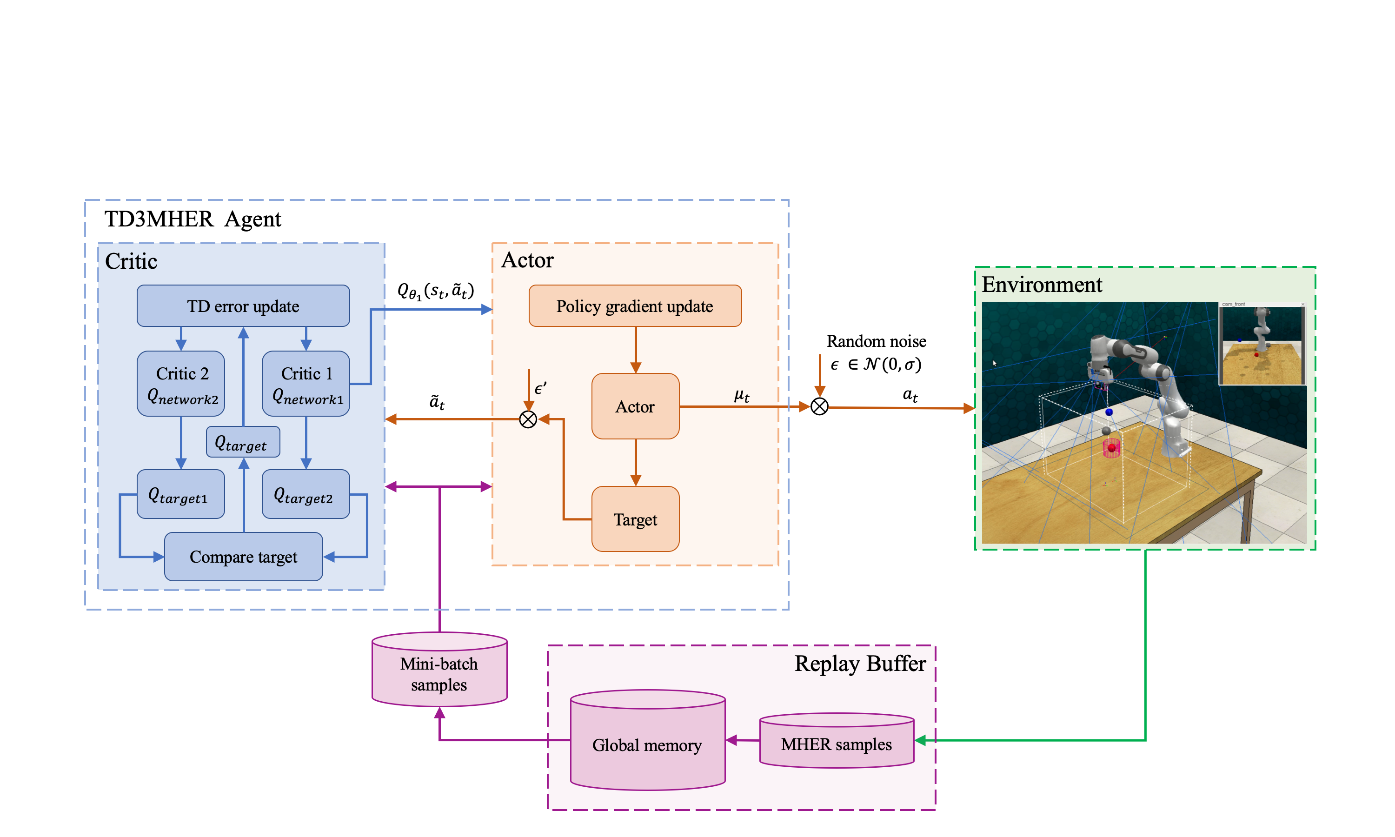
Data-efficient Deep Reinforcement Learning Method Toward Scaling Continuous Robotic Task with Sparse Rewards
Junkai Ren, Yichuan Zhang, Yujun Zeng and Yixing Lan
College of Intelligence Science and Technology,
National University of Defense Technology, China
A model-free, off-policy RL algorithm TD3MHER is proposed to solve continuous tasks with sparse rewards.
TD3MHER motivates the agent to learn the potential physical model of the robot .
TD3MHER use the previously collected samples to train the agent.
TD3MHER is convenient to be applied because it requires no extra exploration.
A figure here
Figure 1. The structure of our proposed method TD3MHER.

