Slide 1
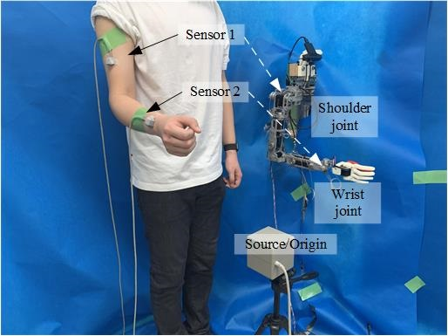
Inverse Kinematics and Master-Slave Control for a 7-DoF Tendon-Driven Humanoid Robot Arm
Zhenyu Sun and Wenyang Li
Department of Mechanical Engineering and Intelligent Systems, The University of Electro-Communications, Japan
Xiaobei Jing and Xu Yong
Shenzhen Institutes of Advanced Technology, China
Analysis of Kinematics and Inverse Kinematics of 7-DOF Robot Arm.
The mapping relationship between robot arm joints and human arm joints.
Research on master-slave control strategy.
Communication based on ROS/ARM/FPGA.
A figure here
Schematic diagram of master-slave control system

