Slide 1
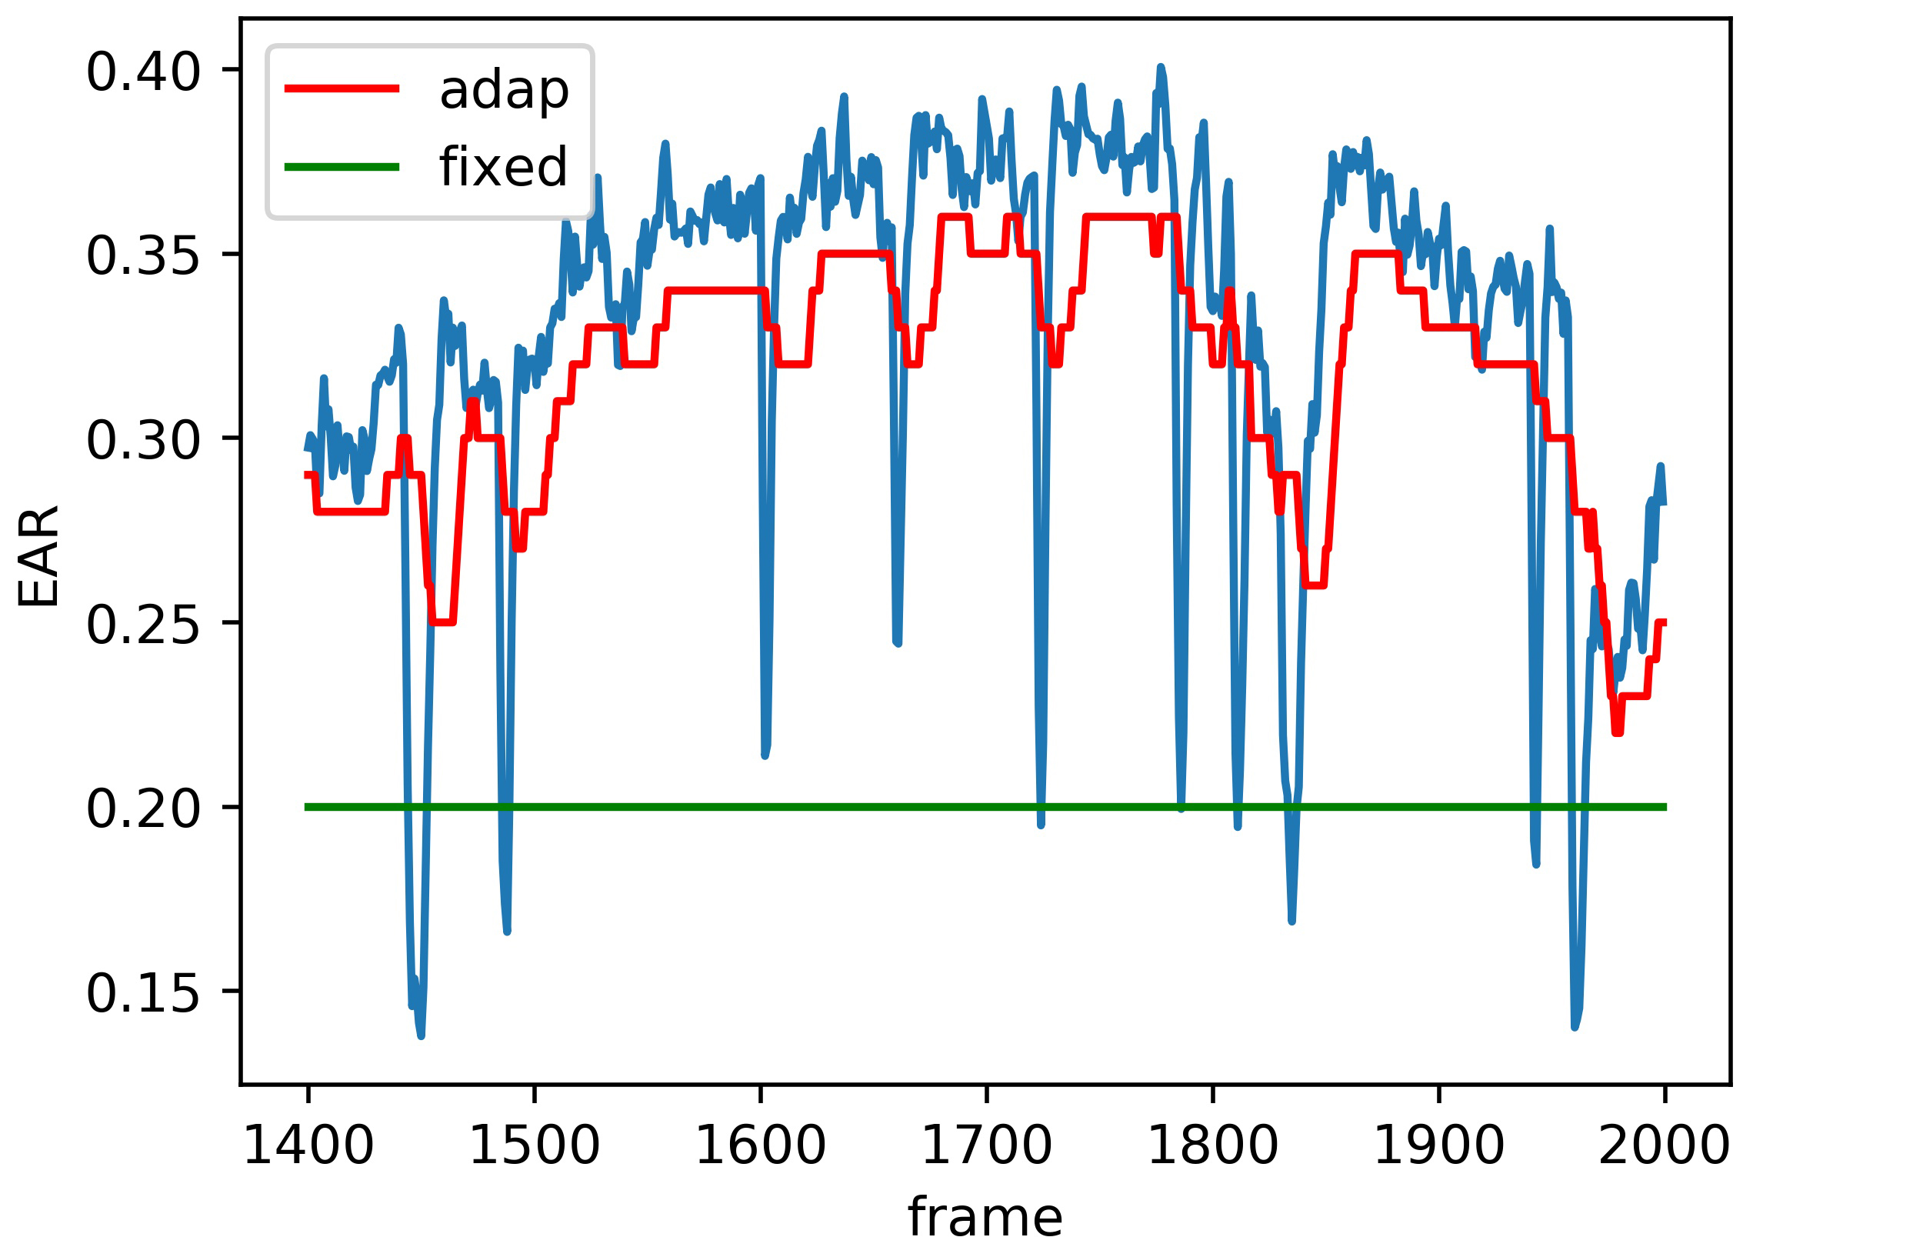
Blink Detection and Duration Estimation by Using Adaptive Threshold
with Considering Individual Difference
Ruitao Liang and Qi Song
the School of Electronic and Information Engineering, Beijing Jiaotong University, China
Dual functions for blink detection and duration estimation.
Real-time blink detection which can adapt to feature changes in individuals and periods.
The blink detection performances on two public datasets are better than the real-time methods compared.
For the estimation of duration, MAE of below 2.5 frames(30fps) can be achieved.
blink waveform captured by adaptive threshold

