Slide 1
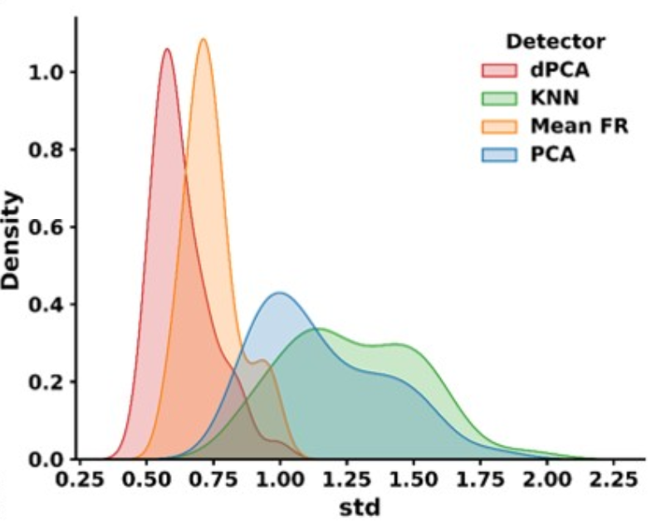
Detecting Movement Timing from Primate Intracortical Signals for Brain-machine Interfaces in Dynamic Environment
Chenyang Li, Yiheng Zhang, Tianwei Wang, Xinxu Xu, Qifan Wang, Ruichen Zheng and He Cui
CAS Key Lab of Primate Neurobiology, CEBSIT, Shanghai
Movement timing recognition is neglected in current BMI decoding.
Detecting movement timing is an outlier detection of recorded intracortical signals from unlabeled dataset.
dPCA-based detector gives the best performance across 9 simultaneously recording set.

