Slide 1
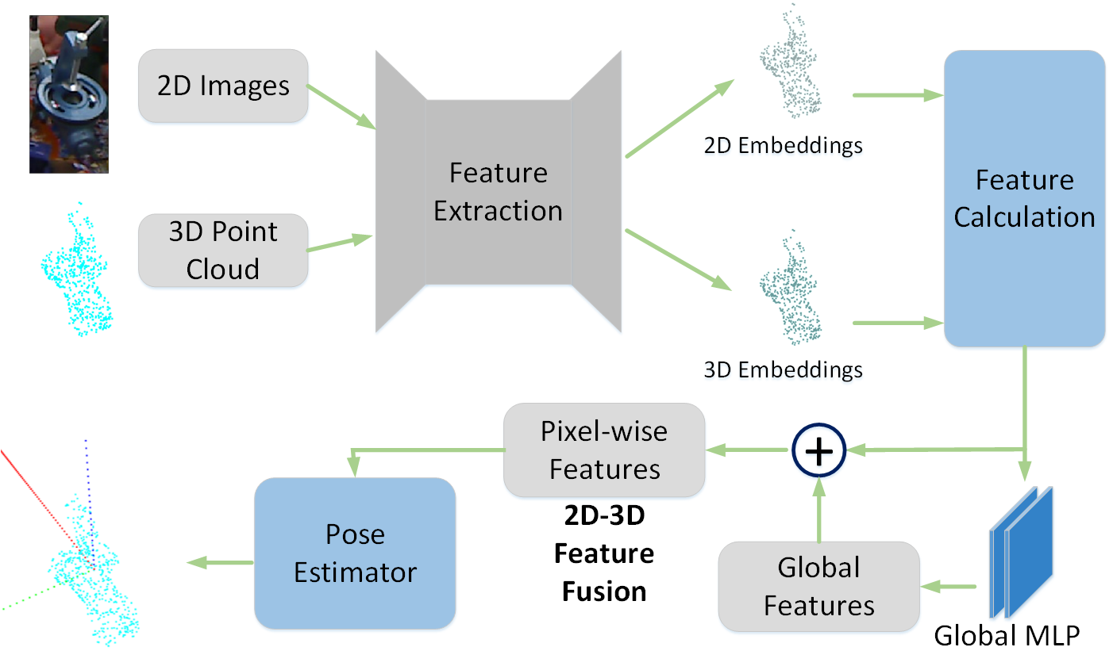
A Depthwise Separable Convolution Based 6D Pose Estimation Network by Efficient 2D-3D Feature Fusion
Qi Feng, Chaochen Gu, Jiani Qin and Rui Xu
Department of Automation, Shanghai Jiao Tong University, China
A novel 2D-3D feature fusion module is proposed to enhance feature extraction in 6D pose estimation network.
The depthwise separable convolution is integrated to our 6D pose estimation network, which drastically accelerates the model training speed and decreases the model storage space, yet achieves on par or better results than state-of-art methods.
A figure here
Architecture of our 6D pose estimation network.

