Slide 1
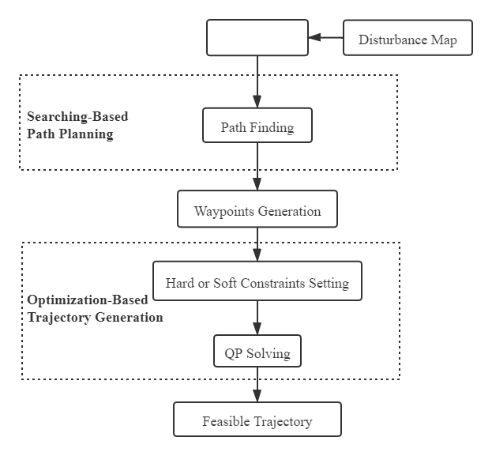

Optimized Underwater Manipulator Path Planning
to Minimize The Disturbance on Robot
Xiaodi Liu , Xin Wang∗ and Xiaotian Cai
Mechanical Engineering and Automation,
Harbin Institute of Technology Shenzhen, China.
The goal of the path planning in this paper is to cause the smallest possible variation in disturbance moments to the robot body.
Generates a disturbance map by data collection, on the basis of which the path search is then carried out.
Develop an algorithm based on the path search of the un_x0002_derwater manipulator and the optimized trajectory generation to minimize the disturbance to the robot body.
.

