Slide 1
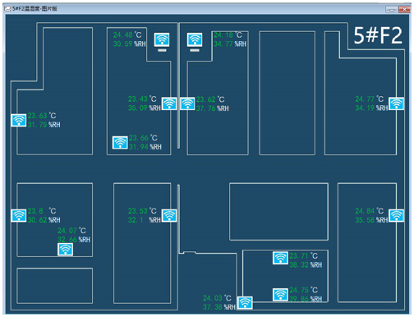
A Study on Wireless Sensor Network Layout Strategy in the Stable Temperature and Humidity Region
Ying Zhao, Weiren Shi, Pengjie Qin, Wenbin
Automation, Chongqing University, China
The stable temperature and humidity region is obtained by CFD, K-Means, and mathematical statistics.
The WSN is laid out in the stable temperature and humidity region.
The WSN is used to design a data processing system.
This study focuses on the tobacco production industry.
A figure here
The view of WSN layout strategy in a stable temperature and humidity region in the data processing system

