Slide 1
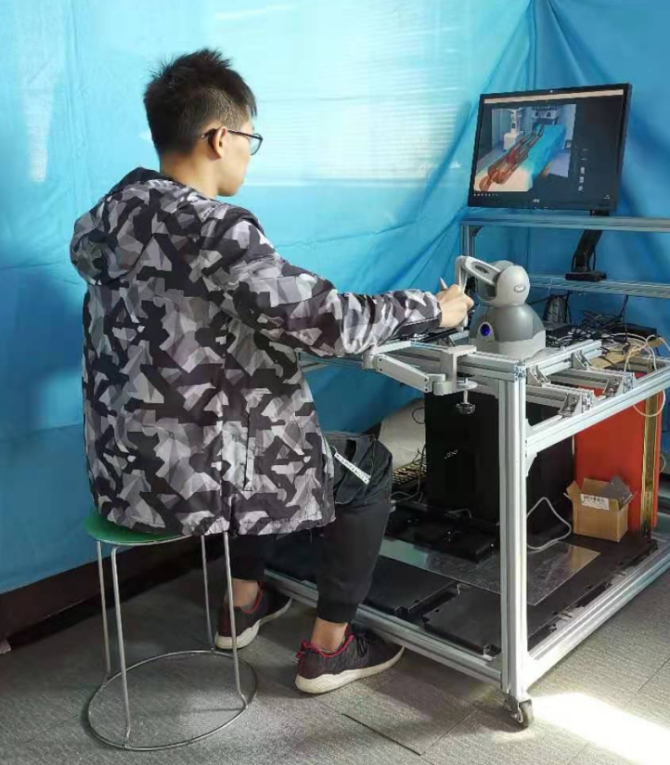
Development of a Virtual Training System for Master-Slave Hip Replacement Surgery
Riwei Zhang, Q. Liu, S. Cai, C. Wang, X. Zhang, L. Duan, Y. Lu, B. Zhang, Z. Wu, J. Guo
School of Automation, Guangdong University of Technology, Guangzhou, China
The First Affiliated Hospital of Shenzhen University, Shenzhen, China
The Virtual Training System helps surgeons to better adapt to the robotic system.
The System improves the surgeons' proficiency in Hip Replacement Surgery.
The System provides vivid and intuitive perception, improves the understanding of the remote manipulation.
For figure caption (optional), use arial narrow 20pt font

