Slide 1
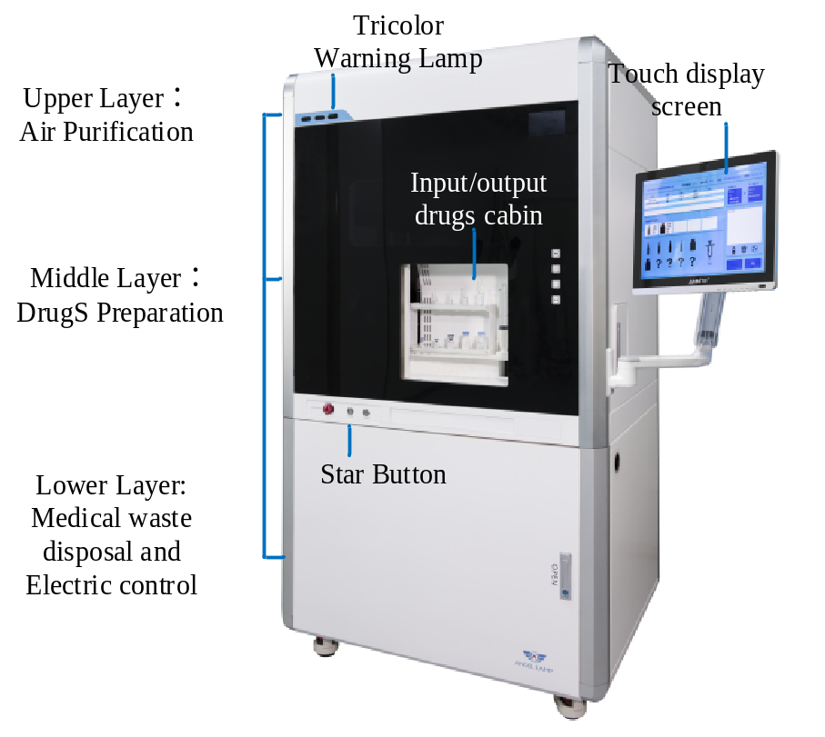
Dispensing robot for toxic drugs in pharmacy intravenous admixture services
H. Jin¹, P. Gao¹, J. Cao¹, Y. He², Y. Hu², Y. Liu³
1-Shenzhen Broadcare Medical Robotics co. Ltd., Shenzhen, China
2-Shenzhen Institute of Advanced Technology, Chinese Academy of Sciences
3-Peking University Shenzhen Hospital, Shenzhen, China
Structural design of dispensing robot on environmental control and protection of toxic drugs
The robot dispensing precise suction scheme for vial and ampoule
Comparative experiment and analysis of suction residue
The overall structure of the dispensing robot

