Slide 1
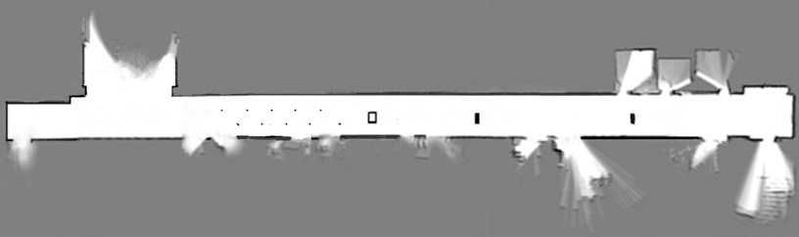
Research on SLAM of Corridor Environment Based on Multi-sensor
Fei Wang , Haiyan Shao Member, IEEE, Qingshuai Zhao
School of Mechanical Engineering, University of Jinan, China
Zhiquan Feng
School of Information Science and Engineering, University of Jinan, China
Firstly, a multi-sensor environment awareness platform was built.
Secondly, the data of each sensor was collected and processed and fusion was realized based on the EKF algorithm of weighted observation multi-sensor.
Finally, the cartographer algorithm was optimized at the back end and the map construction of corridor environment was realized.
Fig.16(b) Optimized cartographer algorithm corridor environment map

