Slide 1
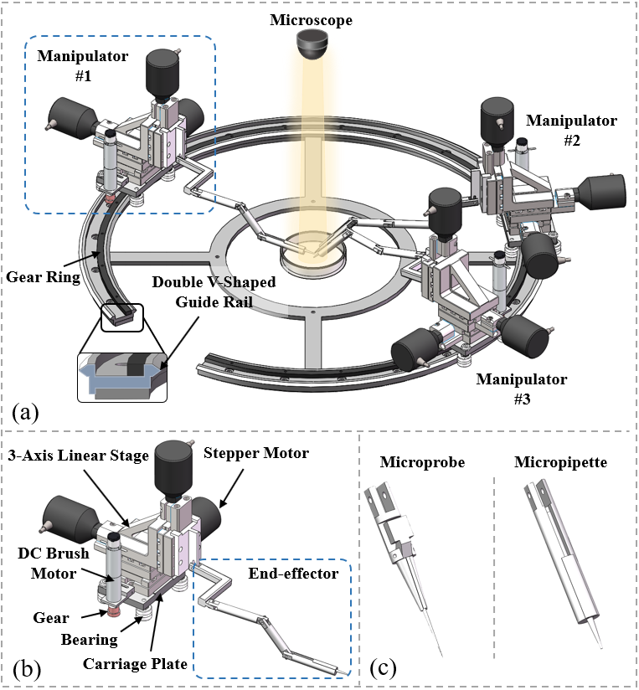
Rail-Guided Robotic System for Multi-Configuration Cooperative Micromanipulation Based on Formation Control
Haojun Hu, Huaping Wang, Qing Shi, Han Tao
Qiang Huang and Toshio Fukuda
Beijing Advanced Innovation Center for Intelligent Robots and Systems,
Beijing Institute of Technology, China
This paper presents a multi-configuration cooperative microrobotic manipulation system for executing multi-process.
The method based on leader-follower and artificial potential field is proposed to achieve multi-configuration formation.
Experimental results have verified the efficacy of the proposed method.

