Slide 1
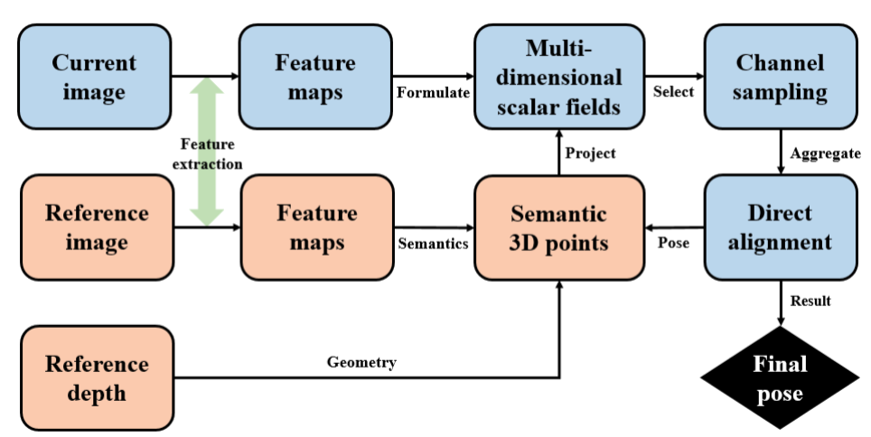
Direct alignment with generalized correspondences: A unified framework for visual pose estimation
Xiaqing Ding, Yue Wang and Rong Xiong
Control Science and Engineering, Zhejiang University, China
A multi-dimension field based unified framework is proposed that can summarize both direct and indirect structure-based visual pose estimation methods, where the differences exist on the data association front-end.
Arbitrary shapes with the same semantic information on different images can be introduced as constraints in this framework without explicit modeling.
A hybrid visual pose estimator is designed based on a three-layer of pyramid constructed with general correspondences to regress pose from coarse to fine.

