Slide 1
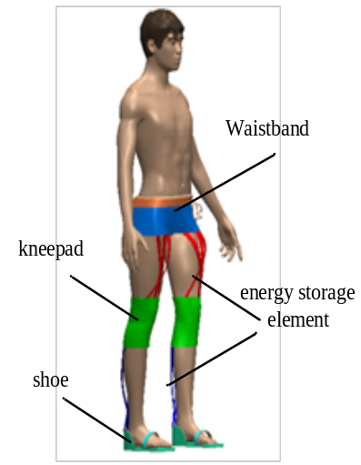
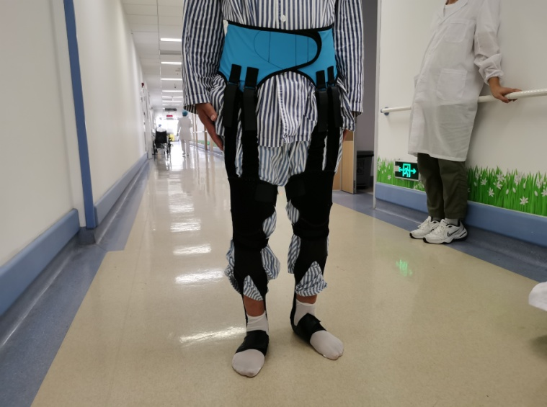
IEEE RCAR 2020
Simulation design of flexible Unpowerd lower limb exoskeleton
Yongfeng Wang, Yanan Diao, Yunkun Ning, Guanglin Li, and Guoru Zhao*
Shenzhen Institutes of Advanced Technology
Hubei Polytechnic University
（1）Conventional unpowered lower limb exoskeleton pay less attention to gait energy efficiency
（2）the structure design forflexible unpowerd lower limb exoskeleton with rubber energy storage element.
(3)the musculoskeletal model with exoskeleton is established, the variable ranges of the elongation of elastic elements for the ankle is bigger than hip during walking
Flexible unpowered lower limb exoskeleton

