Slide 1
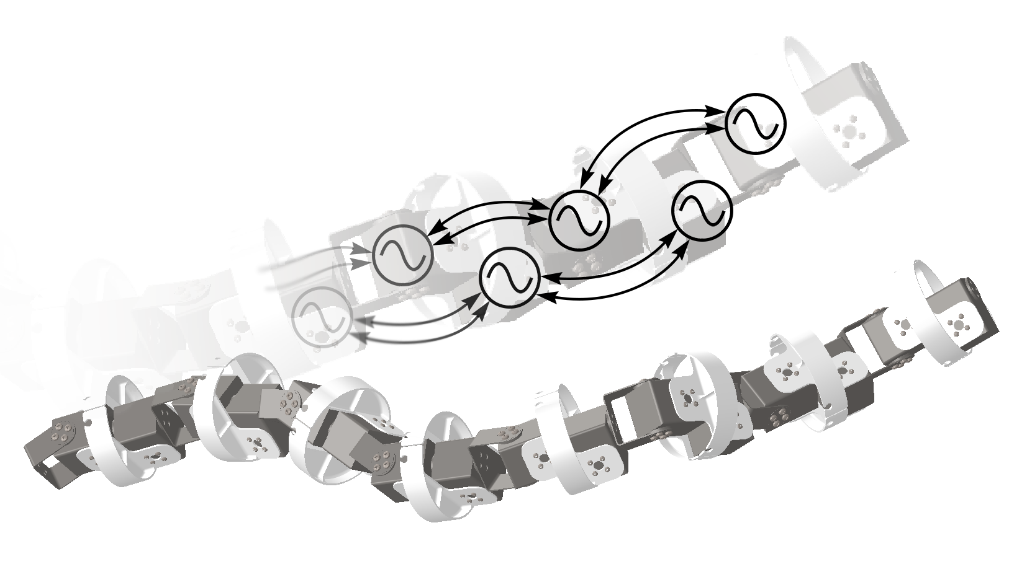
Reinforcement Learning of Serpentine Locomotion for a Snake Robot
Mr. Ke Qiu and Mr. Yikai Lv
School of Mechanical Engineering
Mr. Hang Zhang
College of Electrical Engineering
Mr. Yunkai Wang, Dr. Chunlin Zhou and Dr. Rong Xiong
College of Control Science and Engineering , Zhejiang University, China
The locomotion control of the snake robot.
A central pattern generator (CPG) model for providing serpentine locomotion.
Reinforcement learning (RL) for getting optimal model parameters.
The snake robot and its CPGs, parameters given by an RL controller.

