Slide 1
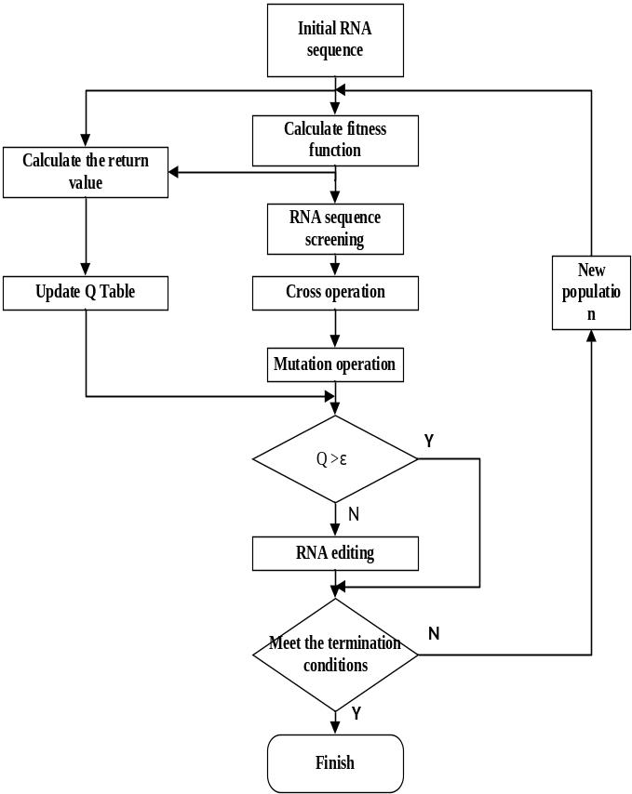
Genetic algorithm based on octopus learning mechanism
Zhang Lifeng and Wu Qiuxuan
School of Automation, Hangzhou Dianzi University, Hangzhou
Use a single RNA chain to represent the individuals of the population.
Imitating the octopus's A-to-G RNA editing method to replace traditional gene mutations, using behavioral learning to design the RNA chain.
Use behavioral learning to design the RNA chain, and determining the possibility of RNA editing by evaluating the RNA chain.

