Slide 1
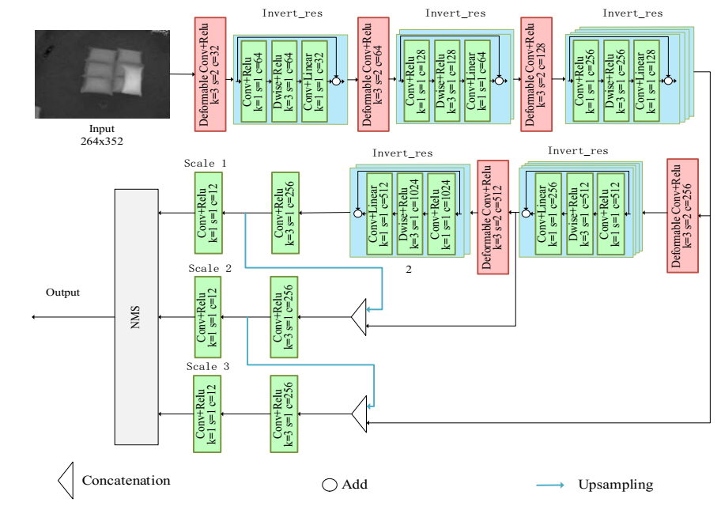
ToF 3D Vision Detection and Localization of Soft Packaging Bags Based on Deep Learning
Chengyang Shen and Weidong Chen
Department of Automation, Shanghai Jiao Tong University, China
ToF 3D Vision
Detection and Localization of Soft Packaging Bags
deep learning

