Slide 1
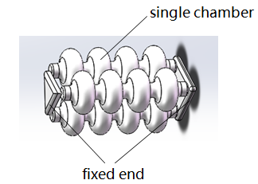
Multi-chamber Pneumatic Actuator for Peristaltic Soft Robot
Sheng GAO, Yue WANG, Rong XIONG, Zhefeng GONG, Nenggan ZHENG, and HaoJian LU
Zhejiang University,China
Dsigned and fabrication the pneumatic corrugated structure driver for squirmy soft robots
Built a set of controller systems to control actuator deformation
Completed the action of forwarding and turning with the actuator on experiments
Structure of the actuator

