Slide 1
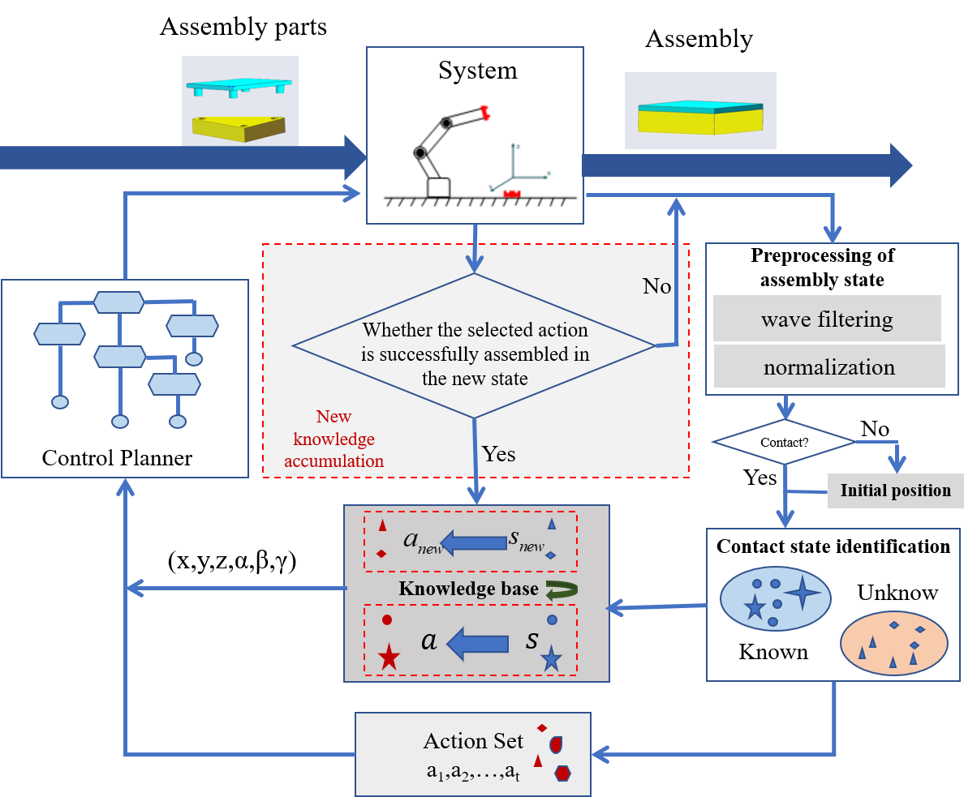
A robot assembly framework with ”perception-action” mapping cognitive learning
FengMing Li, TianYu Fu, GuoQing Chu, Rui Song* and YiBin Li
1 School of Control Science and Engineering, Shandong University,
Jinan, 250061, China
2 School of Mechanical and Electrical Engineering, Harbin Institute of
Technology, Harbin 150006, China
the proposed framework integrates the cognitive recognition and online control strategy of the assembly state.
it can monitor the unknown state of the robot in the process of assembly contact in real time.
It can recognize the new assembly state, update the assembly experience knowledge base in real time, and guide the robot to complete the assembly work.
The assembly cognitive framework

