Slide 1
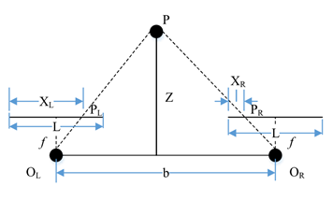
Research on AGV Navigation System Based on Binocular Vision
Changsheng Ai , Dunyang Geng , Zhengguang Qi , Lei Zheng
School Of Mechanical Engineering, University of Jinan, China
Zhiquan Feng
School Of Information Science And Technology, University of Jinan, China
This paper presents an AGV navigation method using binocular camera.
Position and orientation deviation of vehicle body relative to lane line by binocular camera.
The pose deviation of the vehicle body relative to the lane line is verified experimentally.
The experimental results show that the posture obtained by the camera is reliable and stable.

