Slide 1
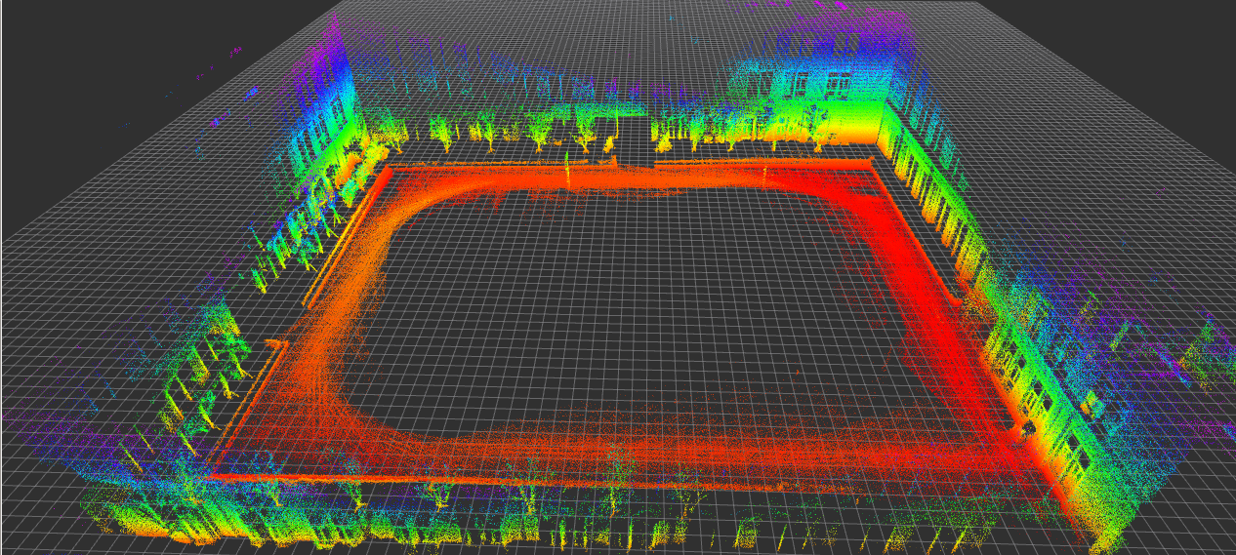
Low-cost and Robust Mapping and Relocalization Method Base on LidarInertial Odometry
Pengfei Qu, Shenliang Li, Jinyang Zhang
Zhansheng Duan and Kuizhi Mei
Department of Electronic and Information Engineering,
Xi’an Jiaotong University, China
The design of low-cost and robust mobile robot platform
Ego-motion estimation with IMU and solid state Lidar
3D point clouds features extraction and selection
The mapping of 3D point clouds and the method of relocalization.

