Slide 1
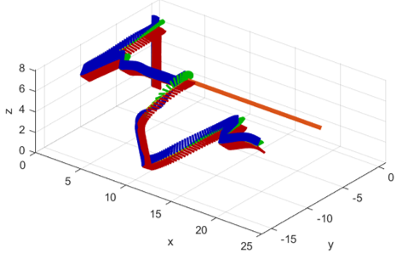
Extreme Maneuvering Control and Planning of Multi-rotor UAV for High-speed Invading Target Avoidance
Wenhao Sun, Xiaoyang Zhang, Guanglian Lin, Hongpeng Wang, Jianda Han
College of Artificial Intelligence, Nankai University, China
Adopt a hybrid control system to control the extreme maneuvering of UAV.
Apply extreme maneuvers to dynamically evade high-speed intrusion targets.
The results are verified by simulation experiments.
Diagram of UAV extreme maneuvering dynamic obstacle avoidance

