Slide 1
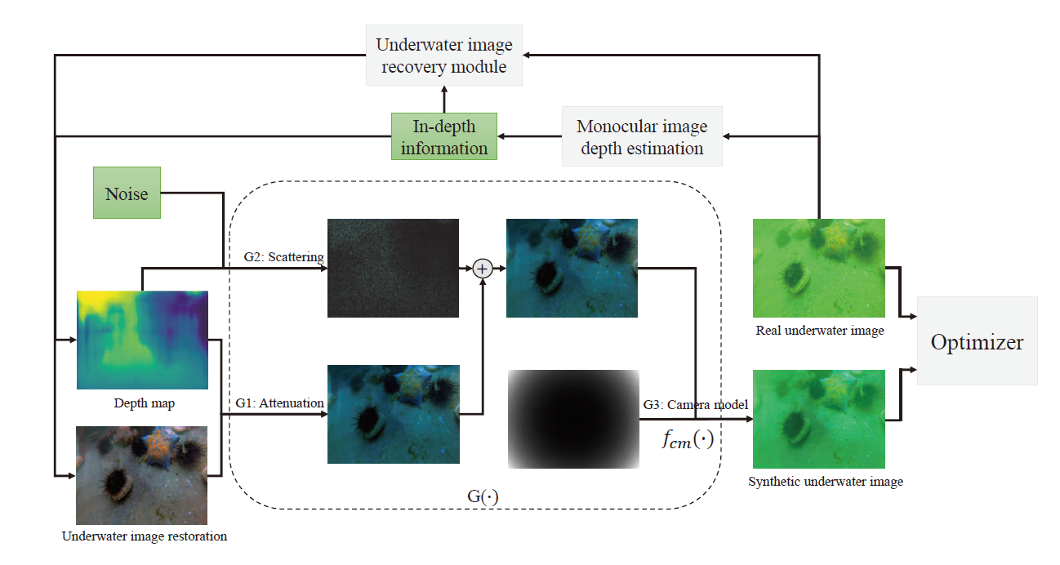
A Novel Underwater Image Synthesis Method Based on a Pixel-LevelSelf-Supervised Training Strategy
Zhiheng Wu, Zhengxing Wu, Yue Lu, Jian Wang and Junzhi Yu
State Key Laboratory of Management and Control for Complex Systems,
Institute of Automation, Chinese Academy of Sciences, China
An underwater image synthesis method is proposed to generate various underwater images.
Pixel-level supervision is designed to make sure the authenticity of the synthetic underwater image.
A self-supervised training strategy is proposed to reduce the difficulty of data preparation and also improve the training performance.
Architecture of the synthesis model.

