Slide 1
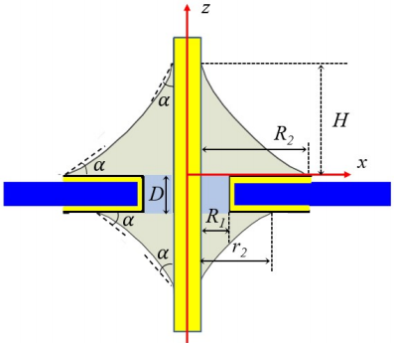
Vision-based soldering process parameters calculation for Robotic soldering
Hao Ren, Xinyu Wu and Wanfeng Shang
Center for Intelligent and Biomimetic Systems, SIAT and CAS, CHINA
Automatic soldering for THT Components
Vision-based automatic soldering process parameters decision.
High-quality soldering result.

