Slide 1
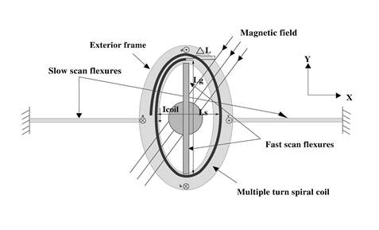
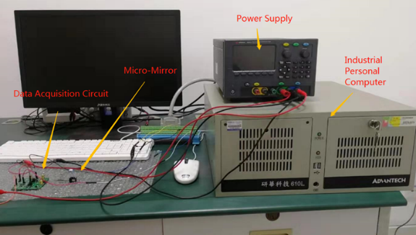
A Predictive Control Scheme for Electromagnetic Scanning Micro-mirrors
Peijun Zheng¹, Ruili Dong¹, Yonghong Tan² and Huiyu Wang¹
1. Donghua University, Shanghai China
2. Shanghai Normal University, Shanghai, China
MEMS electromagnetic scanning micro-mirror (ESMM) is an optical actuator used in optical-electro-mechanical instrument.
The ESMM is a micro-opto-electro-mechanical system with complex characteristics.
A predictive control scheme is proposed for angular control of electromagnetic scanning micro-mirrors.
MEMS micro-mirror control platform

