Slide 1
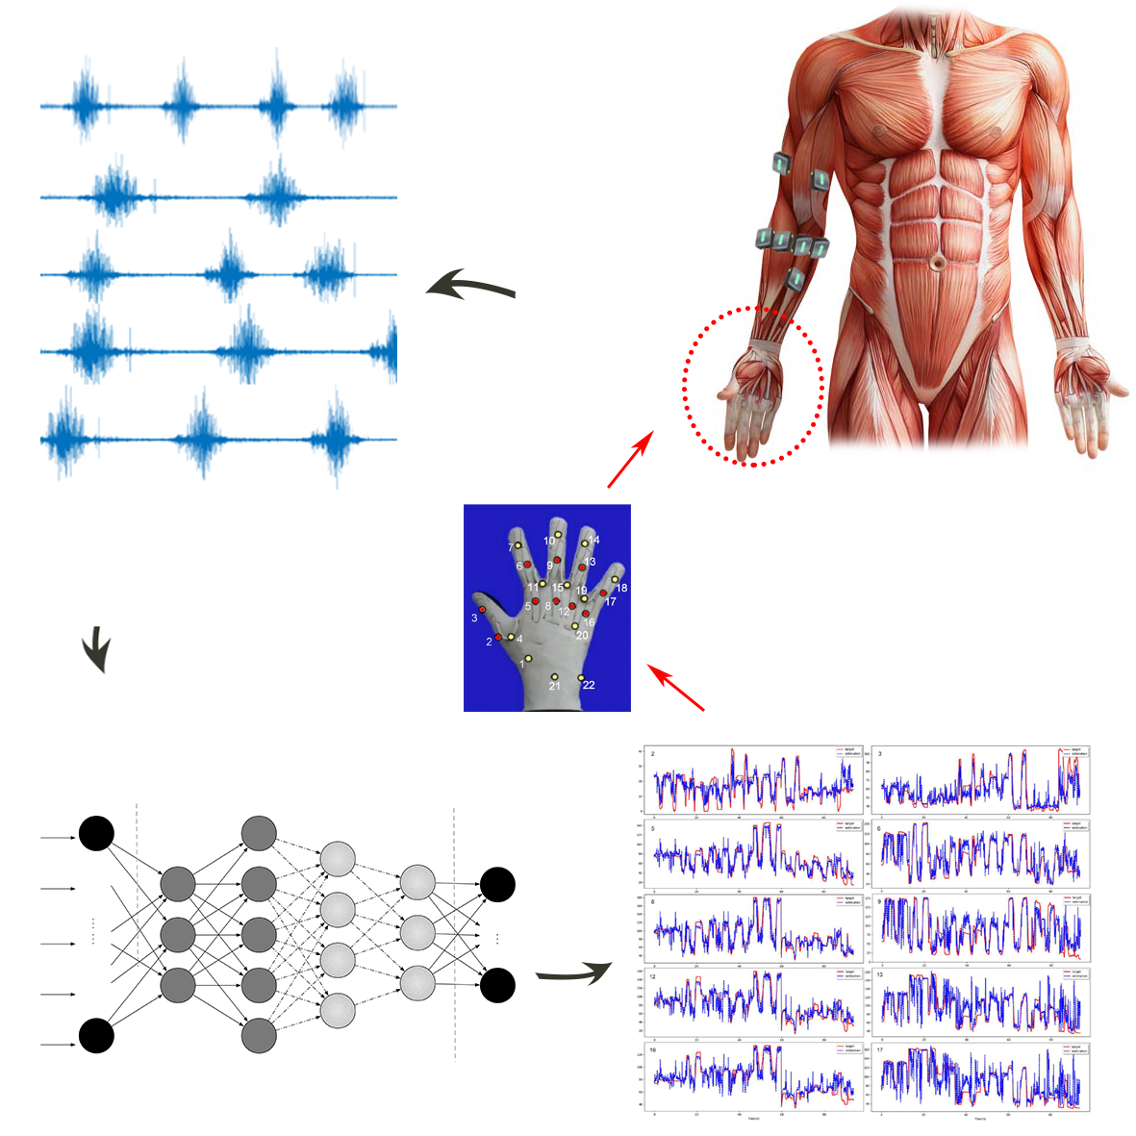
Finger Joint Angle Estimation based on sEMG signals and deep learning method
Chenfei Ma and Lisheng Xu
College of Medicine and Biological Information Engineering, Northeastern University, China
Weiyu Guo and Guanglin Li
Shenzhen Institute of Advanced Technology (SIAT), Chinese Academy of Sciences (CAS)
Continuous finger movement estimation based on sEMG signals
Simultaneous 10 DoFs joint angle output on 8 complex finger movements
Modified AlexNet outperforms ResNet, LSTM and GRU on 8 abled subjects

