Slide 1
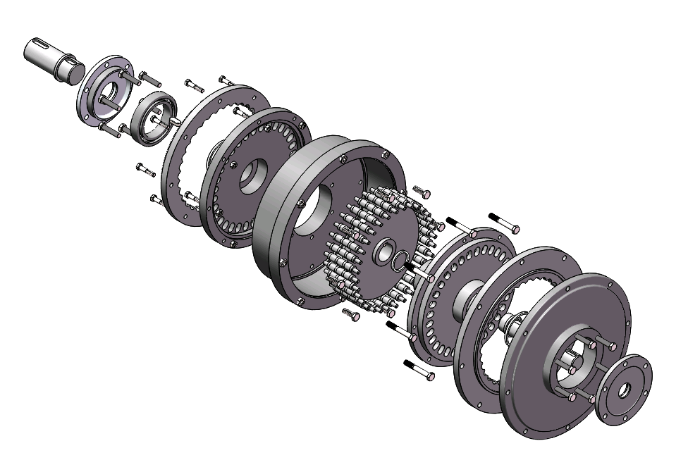
Characteristic Analysis and Virtual Modeling of Two-tooth Difference Rolling Movable Teeth Transmission
Yanfang Wang , Weiwei Song and Rongyu Ge
College of Mechanical Engineering, University of Jinan, China
Structure and Transmission Principle of Two-tooth Difference Rolling Movable Teeth Transmission
Kinematical Pair and Tooth Profile Curve Analysis of Two-tooth Rolling Movable Teeth Transmission
Virtual Modeling of Two-tooth Difference Rolling Movable Teeth Transmission
Exploded view of the two-tooth difference rolling movable teeth transmission

