Slide 1
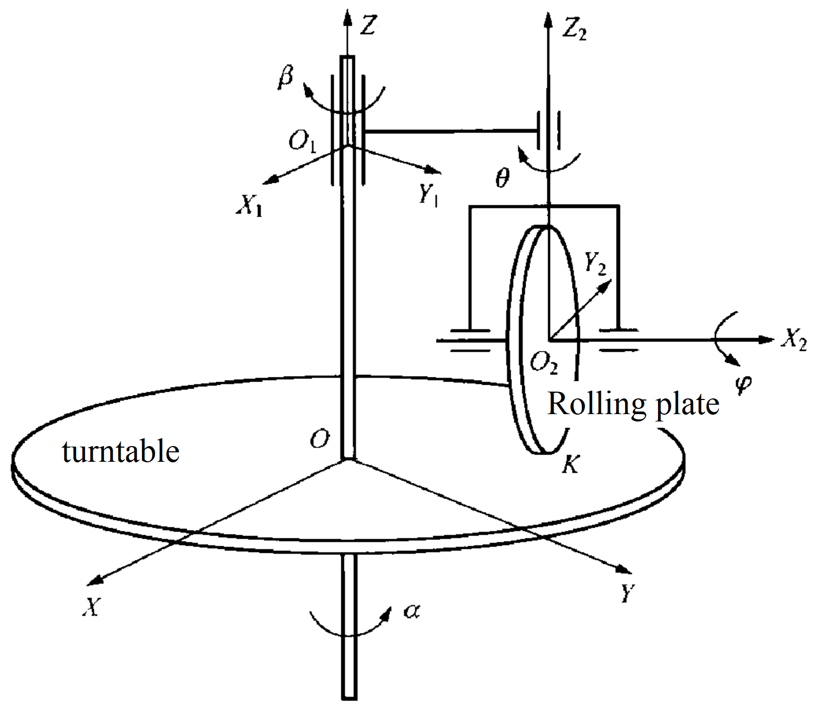
Simplification of Dynamic Equations of a Nonholonomic Motion Transfer Mechanism
Wang Yong, Cui Jinchao, Xiao Jing and Zhang Huailing
School of Biomedical Engineering, Guangdong Medical University, China
The simplification of the dynamic equations may be realized by simplifying the configuration space.
The dynamic equations of first-order linear nonholonomic systems can be given by quasi-Newton's law.
The dynamic equations of the motion transfer mechanism is reduced to the simplest form by quasi-coordinates.

