Slide 1
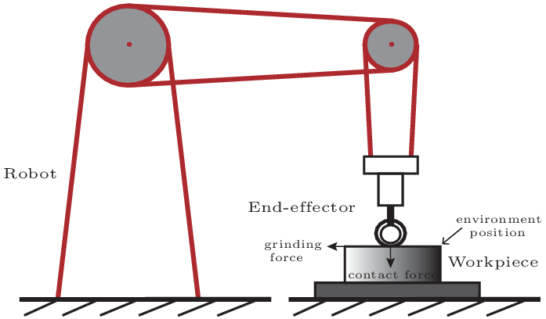
Error Constrained Hybrid Force/Position of a Grinding Robot
Chenglin Zhang, Ning Sun*, Yiheng Chen, Zehao Qiu,
Wenchuang Sang, and Yongchun Fang
Institute of Robotics and Automatic Information Systems,
College of Artificial Intelligence, Nankai University, China
The contact force model between the environment and the robot is presented.
A hybrid force/position control method is given and a force controller is proposed.
By using Lyapunov methods, the stability of the system is proven.
By numerical simulations, the effectiveness of the presented force controller is verified.
Schematic diagram of robot grinding process

