Slide 1
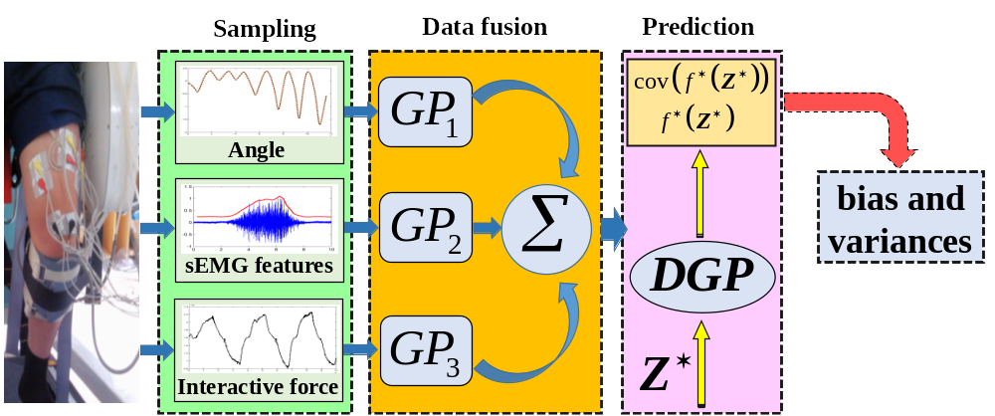
Evolving Gaussian Process based Learning of Knee Angle and Velocity
Jiantao Yang¹, Yong He², Chen He¹, and Ping Shi¹*
1. Institute of Rehabilitation Engineering and Technology, University of
Shanghai for Science and Technology, China
2. CAS Key Laboratory of Human-Machine Intelligence-Synergy Systems,
Shenzhen Institutes of Advanced Technology, China
Dependent Gaussian process is established to fuse multi-source information from each of the human-exoskeleton subsystems.
Gradient estimation model is then performed to obtain the joint velocity.
The proposed model can achieve joint angle and velocity learning without velocity measurement .

