Slide 1
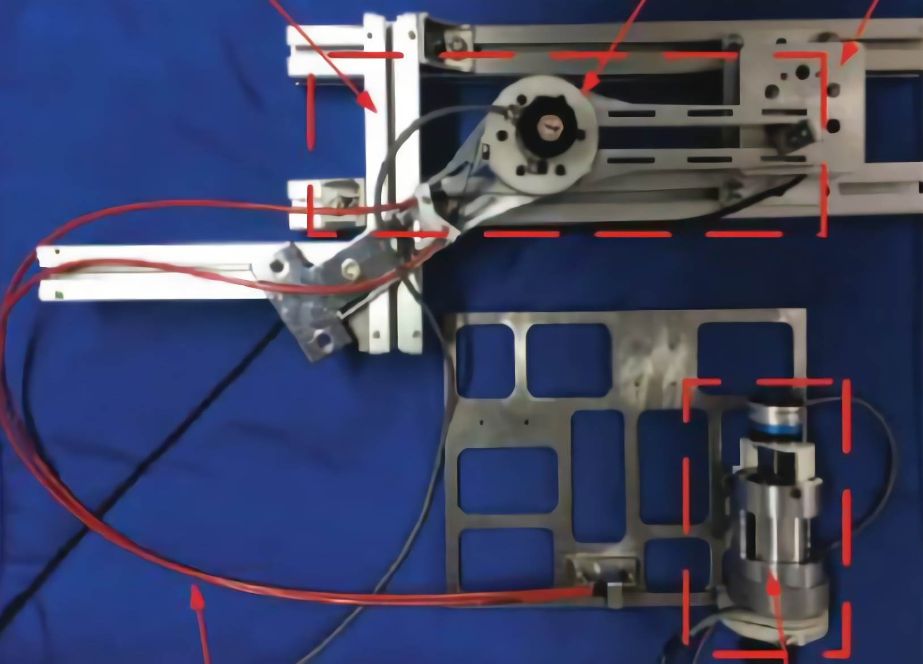
Saturated nonlinear control of robots with series elastic actuators
Jie Cheng, Xuexin Zhang, Tairen Sun
School of Electrical Information and Engineering, Jiangsu University, China
Hongjun Yang
The Institute of Automation, Chinese Academy of Sciences, China
Two saturated nonlinear controllers are proposed based on singular perturbation (SP) and Energy Shaping
(ES).
The SP-based saturated controller requires the stiffness being relative large.
The ES-based saturated controller requires accurate stiffness knowledge.
Use Arial 24pt font for the authors and Arial

