Slide 1
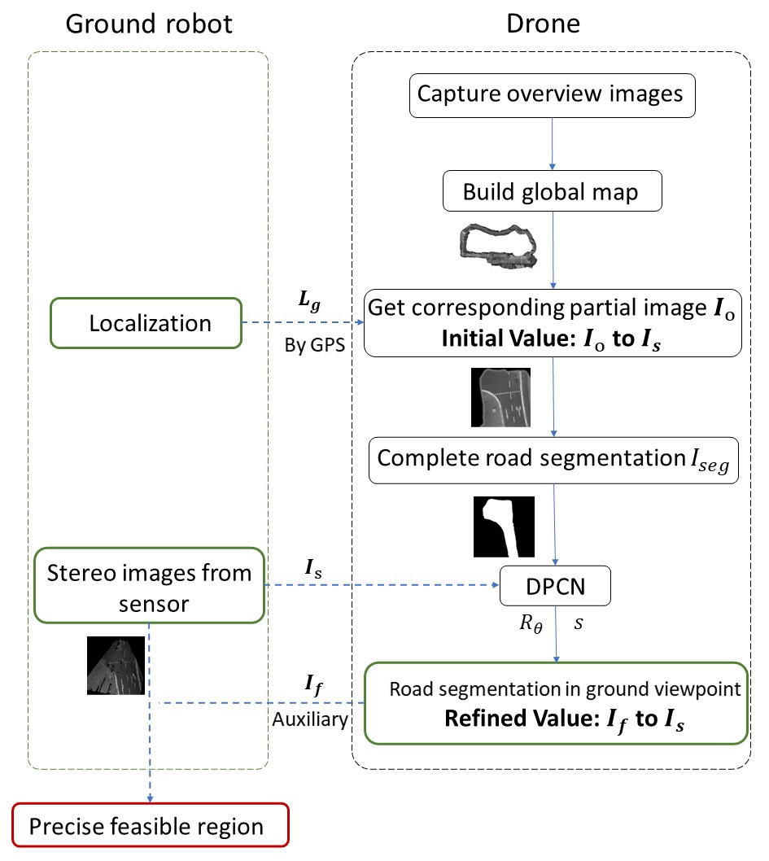
Collaborative Recognition of Feasible Region with Aerial and Ground Robots through DPCN
Yunshuang Li, Zheyuan Huang, Zexi Chen,
Yue Wang and Rong Xiong
Department of Control science and engineering, Zhejiang University, China
A collaborative system with aerial and ground robots is proposed to assist the ground to gain precise information of feasible region.
It contributes to ground robots’ interacting with the environment.
The match between heterogeneous images is done by deep phase correlation network.
Our system has great accuracy and efficiency.
A figure here
For figure caption (optional), use arial narrow 20pt font

