Slide 1
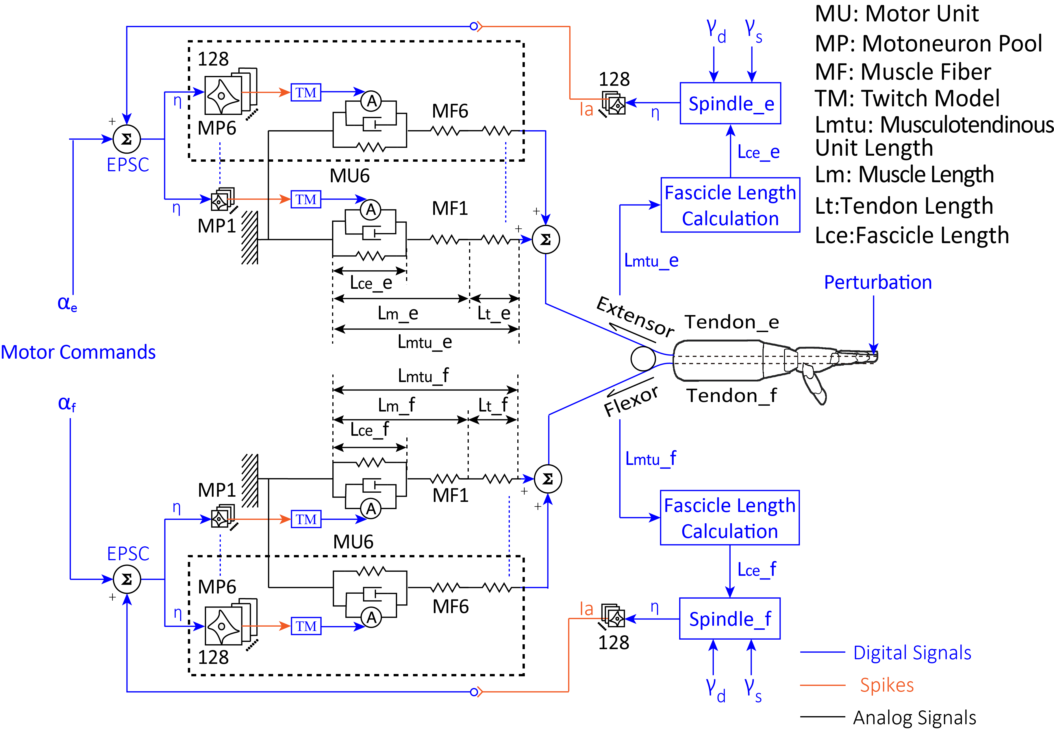
An Integrated Virtual Hand Platform for Evaluation of Model-Based Control of Hand Prosthesis
Zhuo-Zhi Zhang, Jie Zhang, Chuan-Xin M. Niu, and Ning Lan
Laboratory of NeuroRehabilitation Engineering, School of Biomedical Engineering, Shanghai Jiao Tong University, China
Integrate the neuromorphic model of muscles with the ETS-based sensory feedback in the virtual hand platform.
Explore the compliant properties of the model-based biomimetic control system using the tendon-driven virtual hand.
The control mode of the biomimetic controller was automatic switched depending on the external load conditions.
Detailed architecture of the model-based controller.

