Slide 1
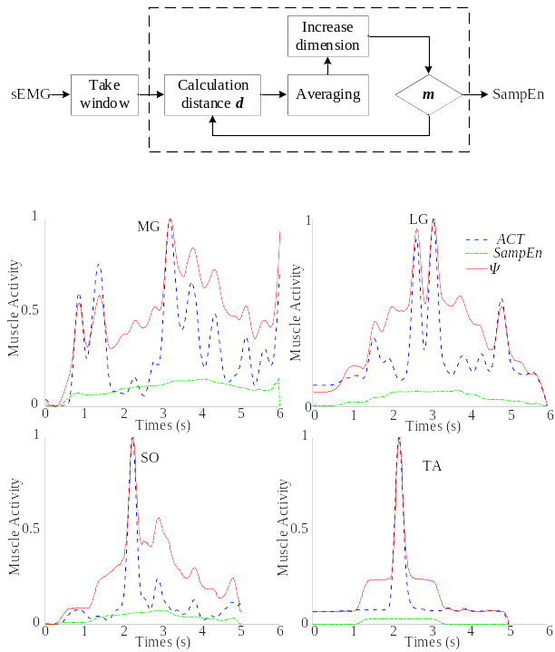
Estimation of muscle activation
during ankle rehabilitation
Jianfeng Li, Yu Zhou, Mingjie Dong* , Ran Jiao
Faculty of Materials and Manufacturing, Beijing University of Technology, China
Liwei Jiang
CSSC System Engineering Research Institute, China
A new method based on sample entropy to judge muscle activation state is proposed.
Sample entropy is used to modify Hill muscle model..
This algorithm is suitable for judging by sEMG.
The muscle activation state during ankle rehabilitation training is measured more accurately.

