Slide 1
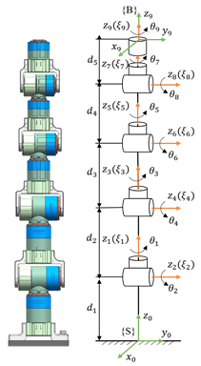
Trajectory Planning for Hyper-Redundant Manipulators Based on Lie Theory
Tianyu Liu and Mingchao Zhu
Space Robot Engineering Center, Changchun Institute of Optics, Fine Mechanics and Physics, Chinese Academy of Sciences, Changchun, China
University of Chinese Academy of Sciences, Beijing, China
A discretized trajectory is generated by the cubic spline interpolation.
Trajectory planning is achieved by finding the numerical solution of inverse kinematics (IK).
IK algorithm combines feedforward and feedback control based on Lie theory.
Redundancy is used to obtain the optimal configuration avoiding joint limits and singularities.
Structure and the geometric twist of the 9-DOF manipulator

