Slide 1
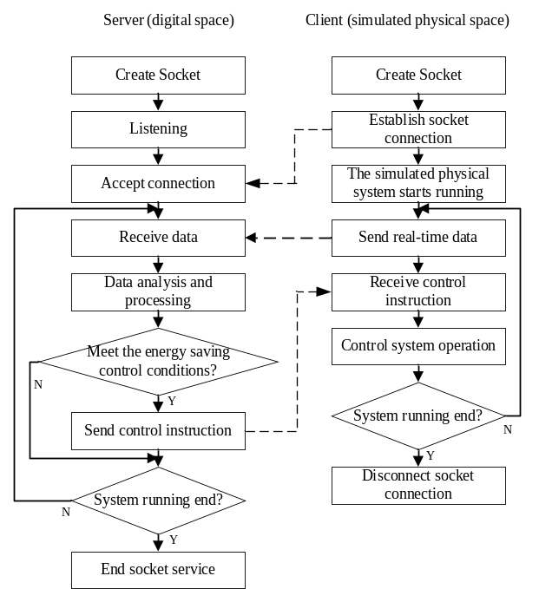
A Digital Twin Simulator for Real Time Energy Saving Control of Serial Manufacturing System
Junfeng Wang, Yaqin Huang and Delian Tang
Department of Industrial and Manufacturing System Engineering,
Huazhong University of Science and Technology, China
A digital twin simulator for the energy saving control of discrete manufacturing system is established and digital twin-based operation framework of energy-efficient manufacturing system is described.
The realization methods of digital twin model, key indicator visualization, as well as the interactive methods between physical space and digital space are discussed.

