Slide 1
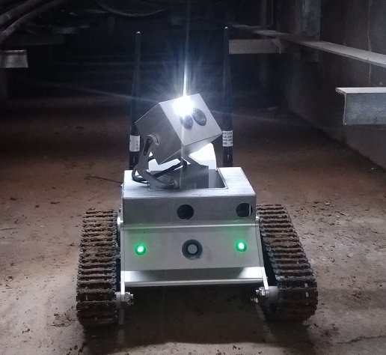
Pan-tilt Control Method
Applied to Mobile Robots
Wei Huang*, Baichuan Den, Wenfeng Zou
the Project manager of Project management center, HuiZhou Power Supply Bureau, Guangdong, China
Runfeng Lou, Tingyi Yuan, Chuqi Xiong
Faculty of Electrical Engineering, Xi'an Jiaotong University, ShanXi, China.
In this paper, particle swarm optimization algorithm is used to optimize the weight and threshold of BP neural network.
BP neural network is used to realize the online control of three parameters of digital PID.
PSO-BP reasonably determine the initial weights of neural network, and overcome the neural network easy to fall into local minimum.
The mobile robot of this paper

