Slide 1
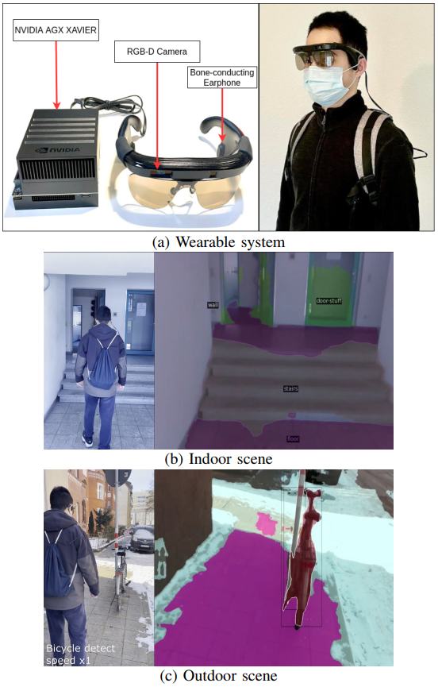
Panoptic Lintention Network: Towards Effcient Navigational Perception for the Visually Impaired
Wei Mao^{1,2} Jiaming Zhang¹ Kailun Yang¹ Rainer Stiefelhagen¹
IAR, Karlsruhe Institute of Technology, Germany
Sino-German School, Tongji University, China
VerConv models Multi-scale and Channel Interactions
Lintention learns long-range dependencies in linear time & space
Panoptic Lintention Net: Fewer Parameters, Fewer FLOPs, Better Performance
A Wearable Assistive System: Fulfill the navigational perception needs of the visually impaired

