Slide 1
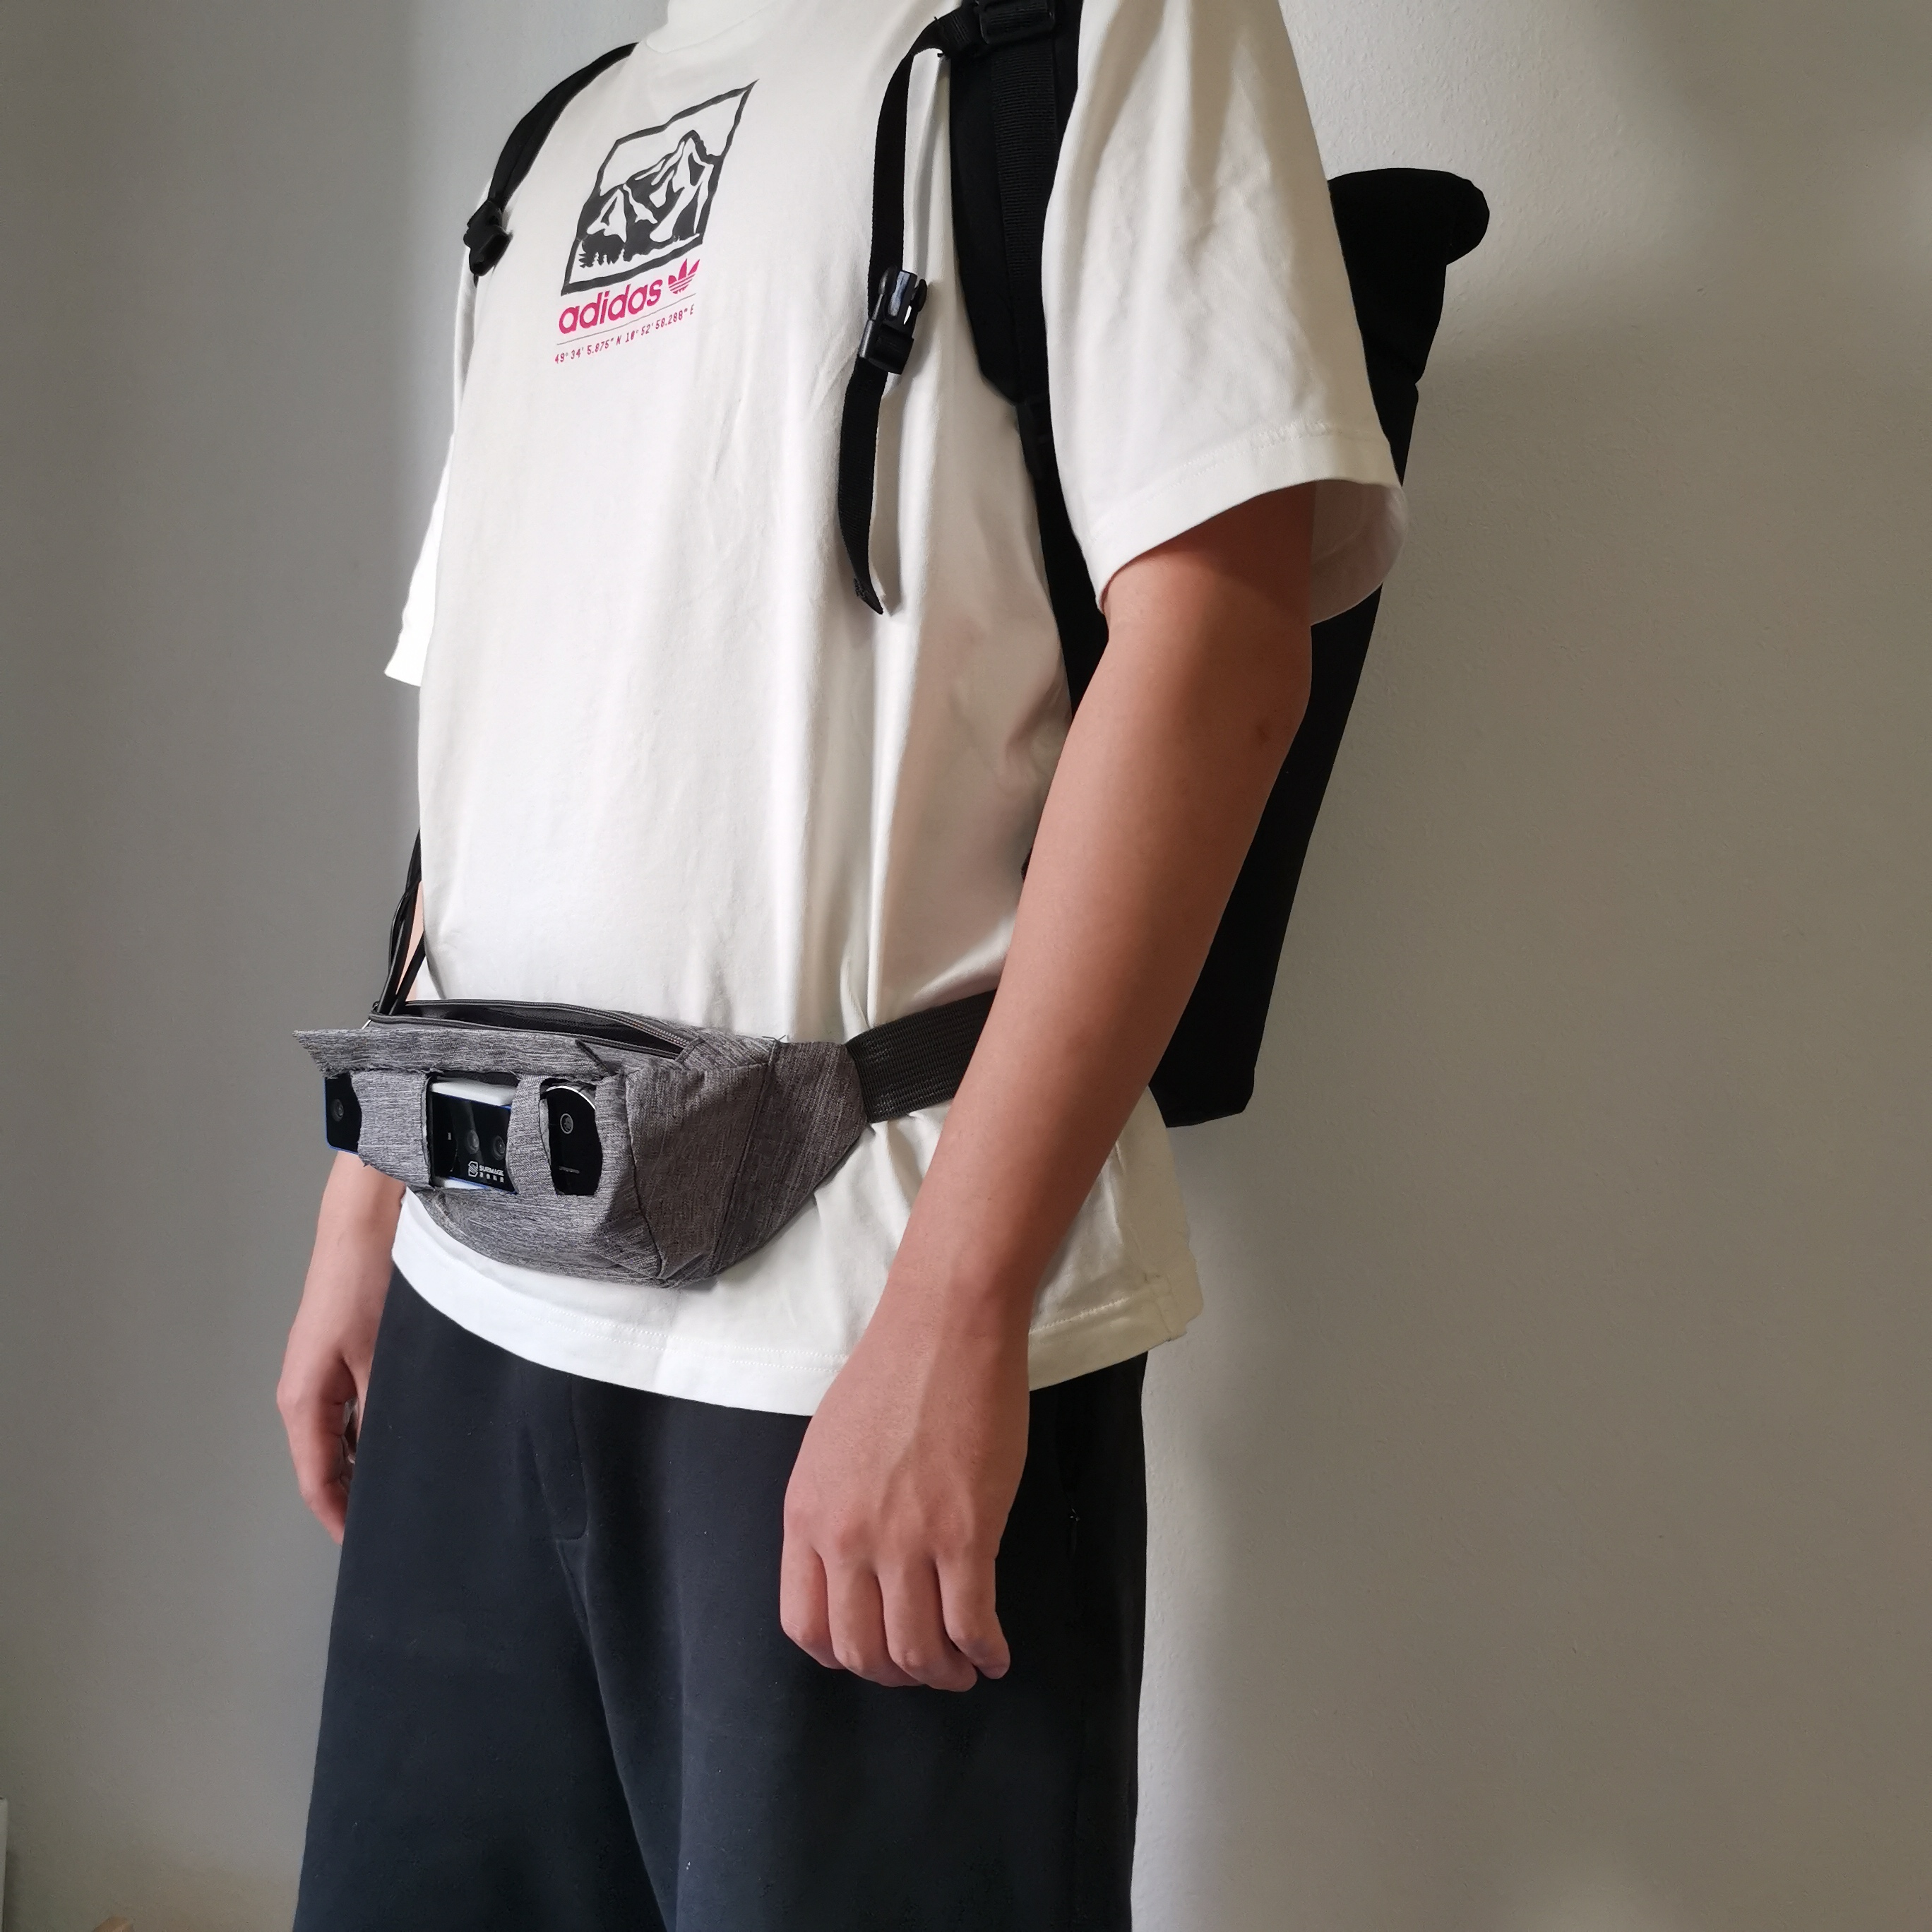
Perception Framework through Real-Time Semantic Segmentation and Scene Recognition on a Wearable System for the Visually Impaired
Yingzhi Zhang, Haoye Chen, Kailun Yang,
Jiaming Zhang and Rainer Stiefelhagen
Institute for Anthropomatics and Robotics,
Karlsruhe Institute of Technology, Germany
We designed a unified perception framework for assisting visually impaired people.
The real-time wearable system based on multi-task architecture feedbacks object information and scene classes via speech signal.
In the experiments, we verified the systems’ accuracy and efficiency on public datasets and real-world scenes.
A figure here
For figure caption (optional), use arial narrow 20pt font

