Slide 1
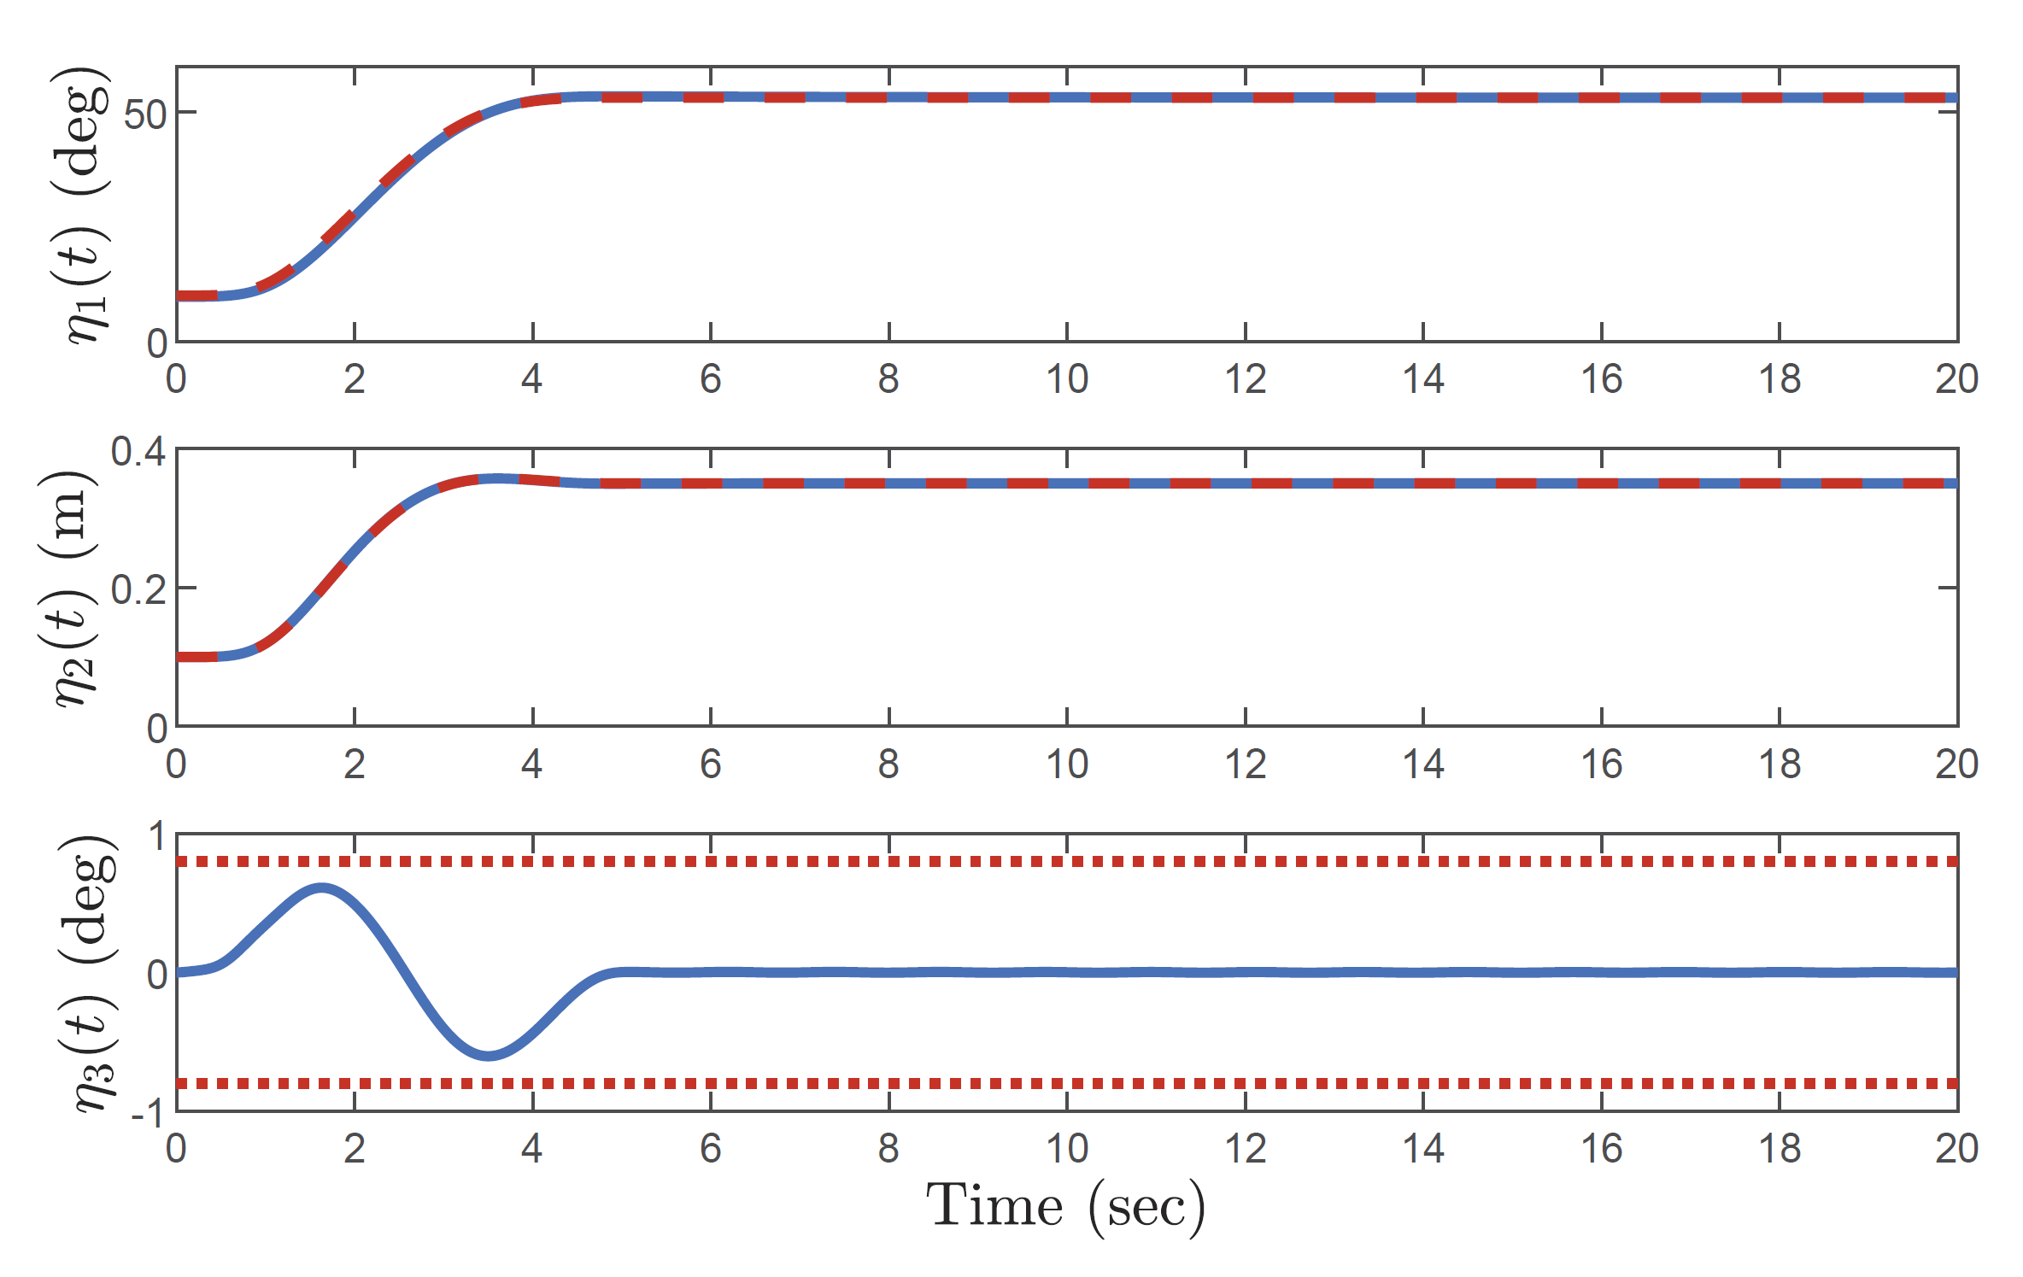
A Time Optimal Trajectory Planning Method for Offshore Cranes With Ship Roll Perturbations
Ran Zhang and He Chen
School of Artificial Intelligence, Hebei University of Technology, China
A time optimal trajectory planning method is proposed for offshore cranes.
Differential flatness property is utilized to better tackle the system couplings.
Different kinds of physical constraints are successfully considered.
A figure here
Simulation results for the proposed optimal trajectory planning method.

