Slide 1
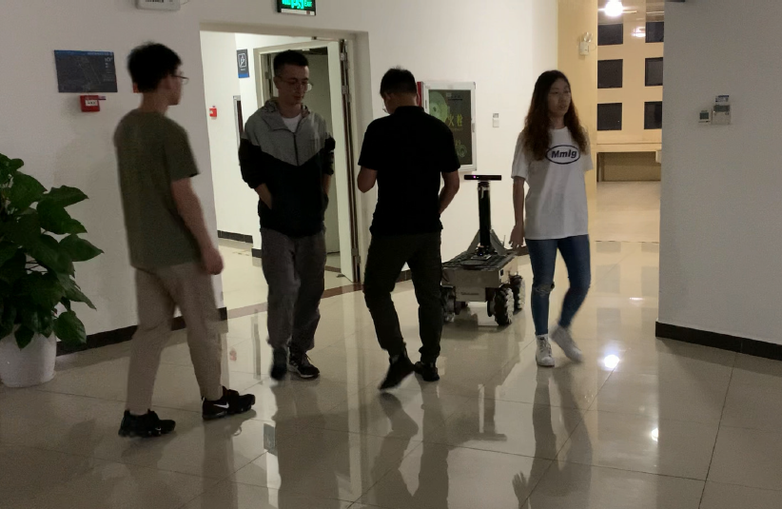
IEEE RCAR 2020 Digest Template
Paper Title in One or Two Lines
Yujing Chen and Yunjiang Lou
School of Mechatronics Engineering and Automation,
Harbin Institute of Technology Shenzhen
We construct a vector field histogram based on the observed static obstacles and pedestrians.
An objective function is proposed to get an optimal direction of the mobile robot.
We introduce a fuzzy inference system to generate smooth and efficient motion.
The proposed planner is tested on a robot in various densely crowded scenarios
A figure here
Robot navigation in dense crowds by the proposed planner

