Slide 1
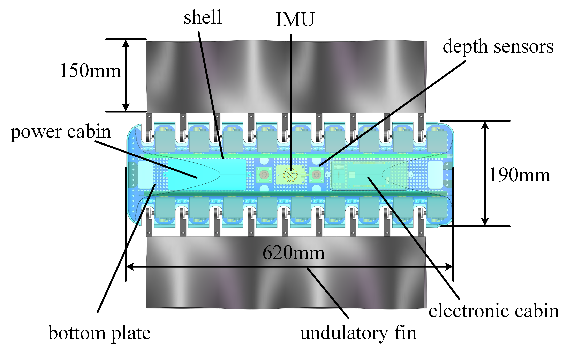
Kinetic Analysis and Design of a Bio-Inspired Amphibious Robot with Two Undulatory Fins
Shenglin Yin, Qiao Hu*, Yangbin Zeng, Chang Wei, Zhenhan Chen
School of Mechanical Engineering, Xi'an Jiaotong University, China
A bio-inspired amphibious robot featuring with two undulatory fins.
The kinetic analysis of the undulatory fin propulsion both underwater and on the ground.
The prototype design are presented in detail.
Three-dimensional movements test as well as ground propulsion test are introduced.

