Slide 1
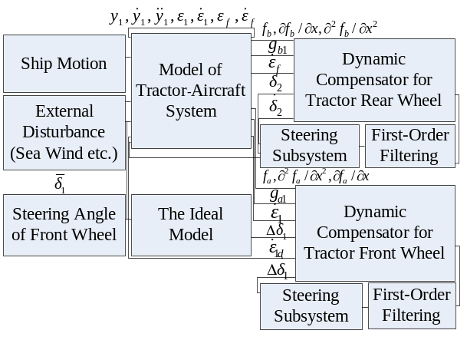
A Stability Control Strategy for Tractor-Aircraft System on Deck
Hongbo Liu and Xiaodong Yang
School of Mechanical and Power Engineering,
Harbin University of Science and Technology, China
Nengjian Wang
Mechanical and Electrical Engineering department, Harbin Engineering University , China
An active rear-wheel steering and compensative front-wheel steering control strategy is presented.
Aircraft parameters diversity, marine environment uncertainty and the characteristics of steering subsystem are considered.
The proposed controller provides the basic robustness to parametric uncertainties and external disturbance.
Control Strategy Model of Traction System on Deck

