Slide 1
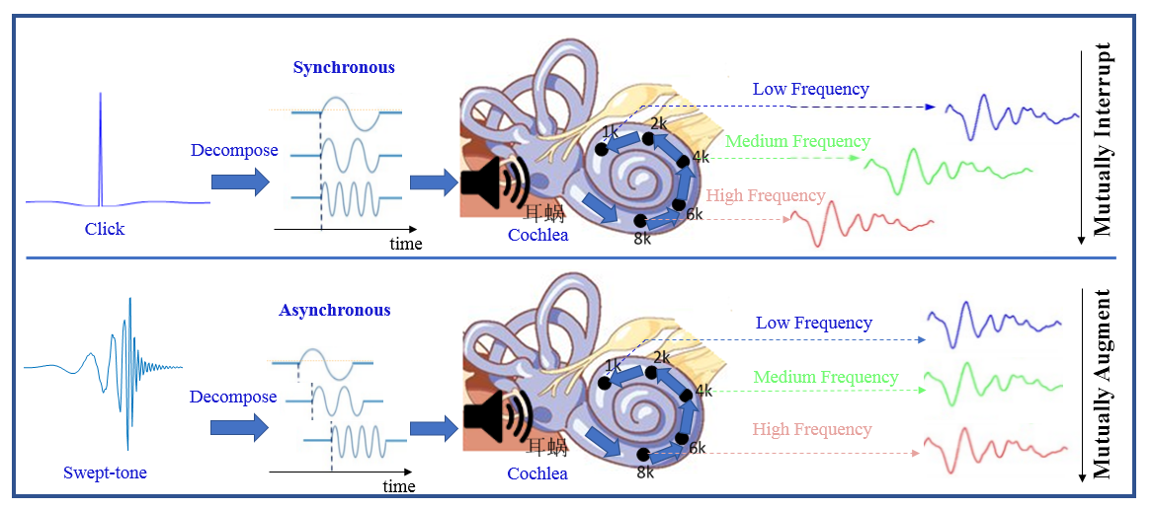
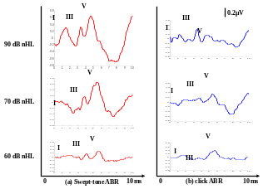
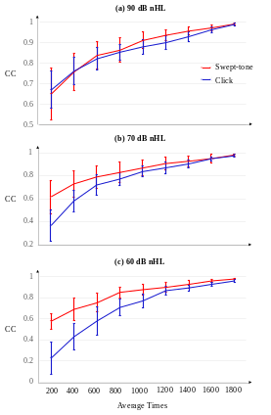
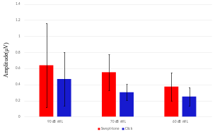
Auditory Brainstem Responses evoked by Swept-tone in Unilateral Sensorineural Hearing Loss Patients
Xin Wang#, Jingqian Tan#, Boya Wang, Mingxing Zhu, Yao Pi, Xiaochen Wang, Cheng Wang, Chen Wang, Feng Wan, Shixiong Chen* and Guanglin Li
Shenzhen Institutes of Advanced Technology, Chinese Academy of Sciences, Shenzhen
Shenzhen College of Advanced Technology, University of Chinese Academy of Sciences, Shenzhen
Guangdong-Hong Kong-Macao Joint Laboratory of Human-Machine Intelligence-Synergy Systems, Shenzhen
A swept-tone method which adjusted the show-up times of different frequency components based on the basilar-membrane model is proposed.
The proposed swept-tone method in ABR test shows advantages on morphology, time-saving, and hearing threshold evaluation.
The swept-tone ABR could help with more accurate and efficient disease diagnosis.

