Slide 1
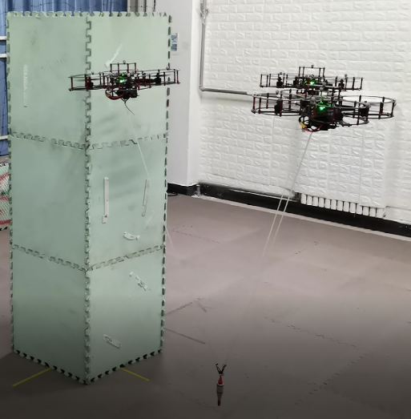
Trajectory Planning for Collaborative Transportation by Tethered Multi-UAVs
Chongxu Pei and Fan Zhang and Panfeng Huang and Hang Yu
Research Center for Intelligent Robotics,
Northwestern Polytechnical University, China
A multi-robot cooperative trajectory planning method with constraints is proposed.
A Hybrid A* algorithm with cluster obstacle avoidance is used for path search.
Some special rope constraints of UAV swarm flight are defined.
The trajectory is optimized by nonlinear optimization with the problem of trajectory smoothing.
Collaborative Transportation by Tethered Multi-UAVs

