Slide 1
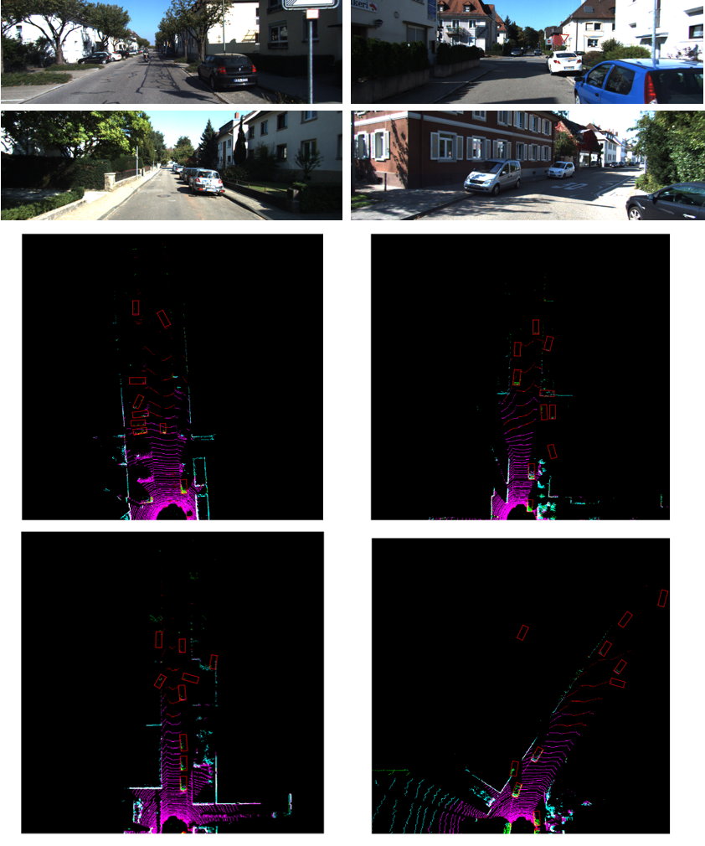
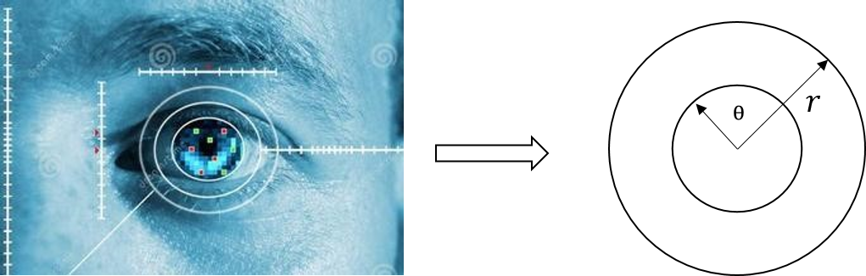
3D LiDAR Point Cloud Loop Detection Based on Dynamic Object Removal
Pan-Yun Ding, Zhi-Hui Wang
School of Computer Science and Engineering, Nanjing University of Science and Technology, Nanjing 210094, China;
3D object detection model OpenPCDet is employed to detect dynamic objects in the outdoor scene, such as vehicles, pedestrians, etc.
We use the bounding box detected by the model to perform cube filtering on the original data to remove dynamics objects.
The processed data is utilized to extract scene descriptors for loop detection. In the road scene, experimental results demonstrate that our approach yields superior performance against the traditional methods.

