Slide 1
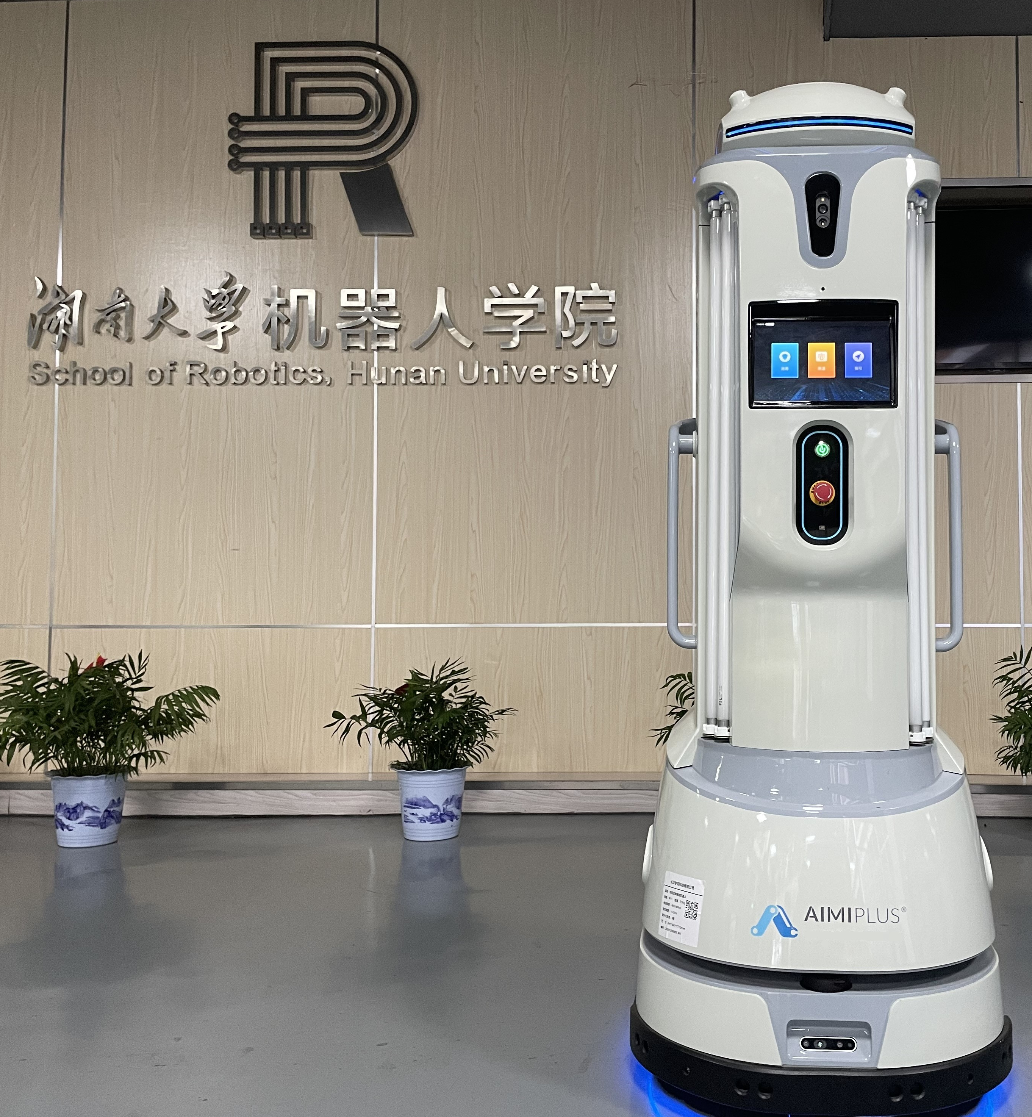
Research on Graph-Based SLAM for UVC Disinfection Robot
Xuan Tan and Xidong Zhou
College of Electrical and Information Engineering,
Changsha University of Science and Technology, China
Hui Zhang, Hang Zhong and Li Liu
School of Robotics, Hunan University, China
The aim of the present work is to contribute in the fight against the spread of Covid-19.
It can automatically, efficiently and accurately carry out autonomous mobile disinfection of the hospital indoor environment.
The real-time localization accuracy is about 0.04m, which provides high reliability localization for autonomous navigation.
Aimi-Robot UVC

