Slide 1
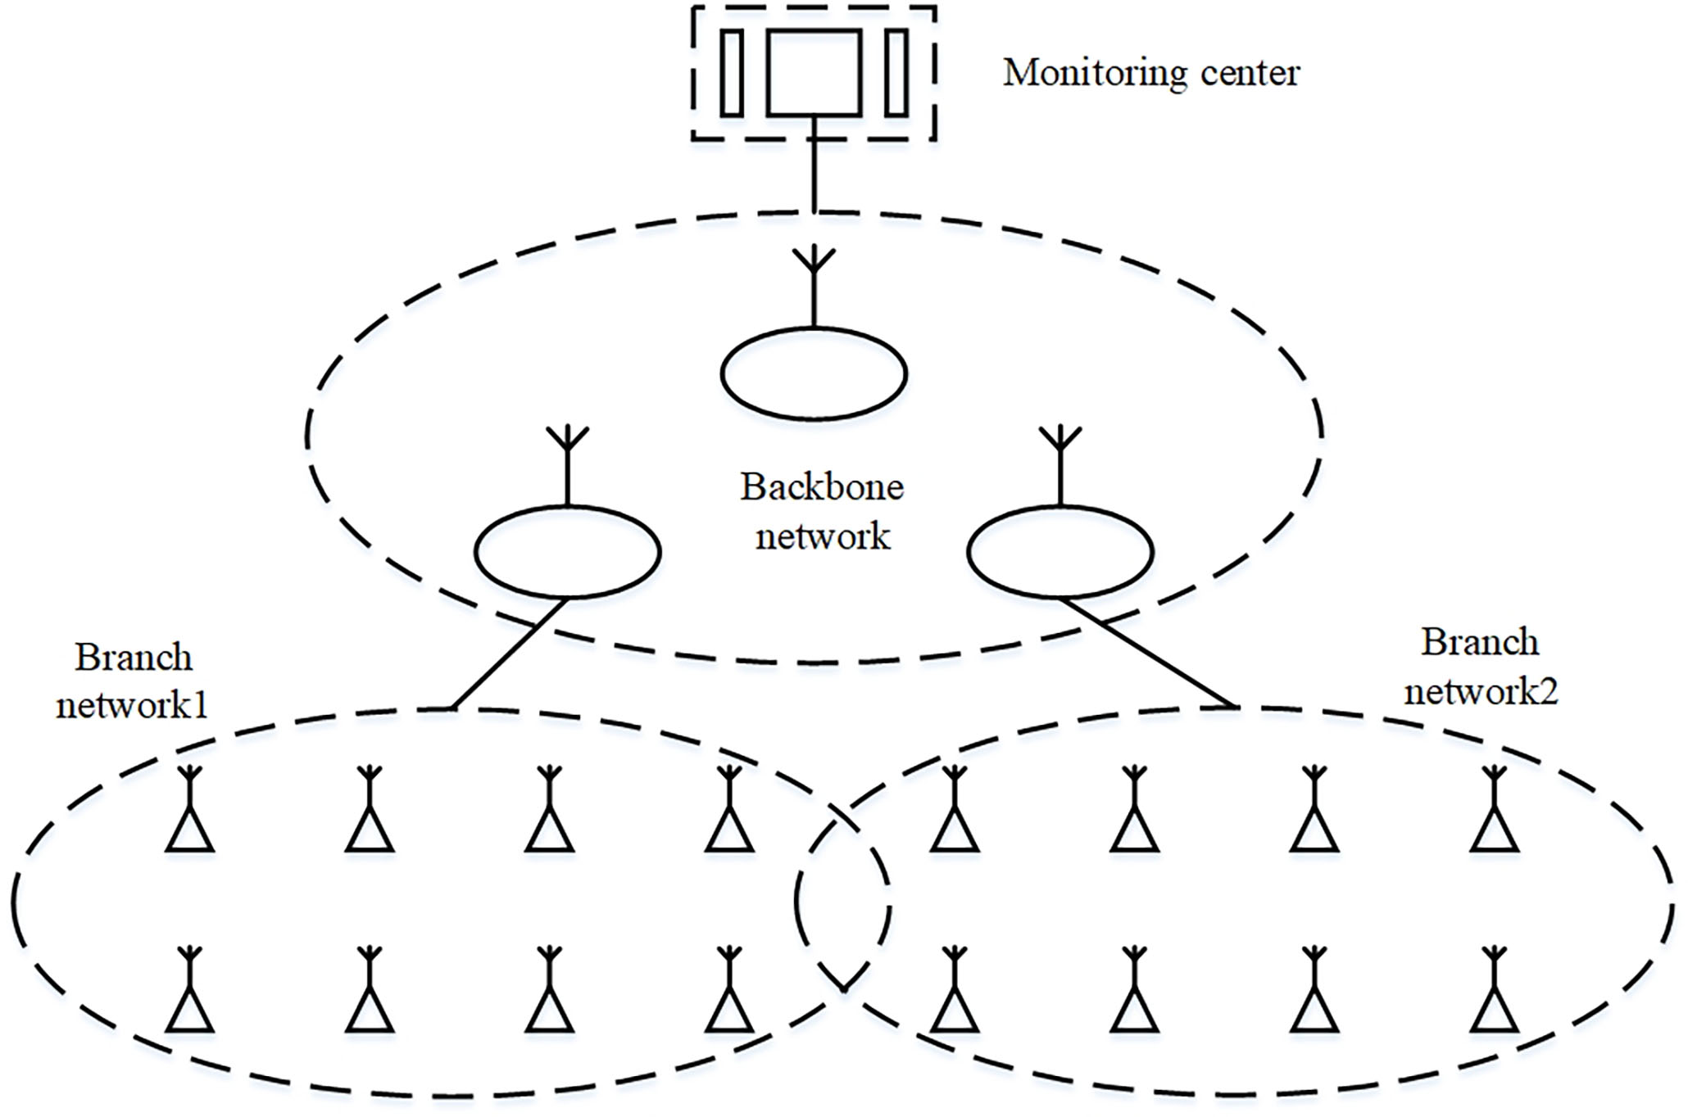
Environmental Monitoring System Based on Hybrid Mode Network
Zhishuo Li^{1, 2} , Guodong Yang^{1,2}, En Li¹, Zize Liang¹
¹State Key Laboratory of Management and Control for Complex Systems, Institute of Automation, Chinese Academy of Sciences, China
²University of Chinese Academy of Sciences, China
This paper proposes a hybrid network structure based on the ZigBee and Mesh
It consists of the backbone network, branch network, and monitoring center
It has the advantage of long transmission distance, large bandwidth, and low cost.
A figure here
Structure of the system

