Slide 1
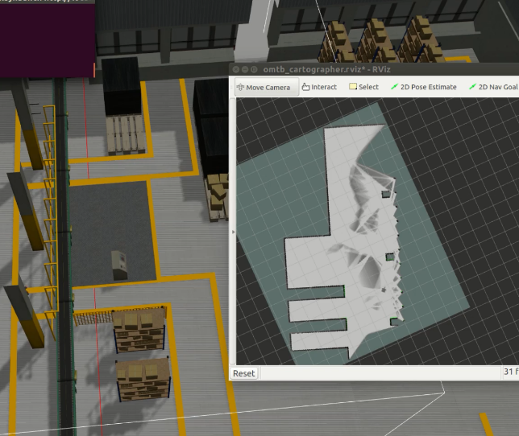
Construction and evaluation of SLAM and navigation system for mobile robot based on diverse environments
Haodong Wang ,Wei Guo and Yu Fu
the State Key Laboratory of Robotics,
Harbin Institute of technology, China
Construction of diversified environment and robot system
SLAM trajectory and computer resource evolution
TF coordinates and ground truth extraction
A figure here

